Slide 1
Simulated transition from RCP8.5 to RCP4.5 through three different Radiation Management techniques
GC31I-01
http://expected.bitbucket.org
Jón Egill Kristjánsson, Helene Muri, Muralidhar Adakudlu, Alf Grini, Siv K Lauvset, Odd Helge Otterå, Michael Schulz, Jerry F Tjiputra
helene.muri@geo.uio.no
Notes:
Session Number and Title: GC31I: Multidisciplinary Assessments of Radiation Management Geoengineering II
Location: Moscone West; 3005
https://agu.confex.com/agu/fm16/meetingapp.cgi/Paper/129045

Slide 2
Method
Caveat: assuming this works …
Model details:
NorESM1-ME with interactive biogeochemistry
1.9x2.5° lat x lon resolution
26 vertical levels
3 realisations.
SAI: prescribed aerosol layer.
MSB: increased emissions of accumulation mode sea salt aerosols ±45° lat.
CCT: increase in ice crystal fall speed for T < -38°C.

Slide 3
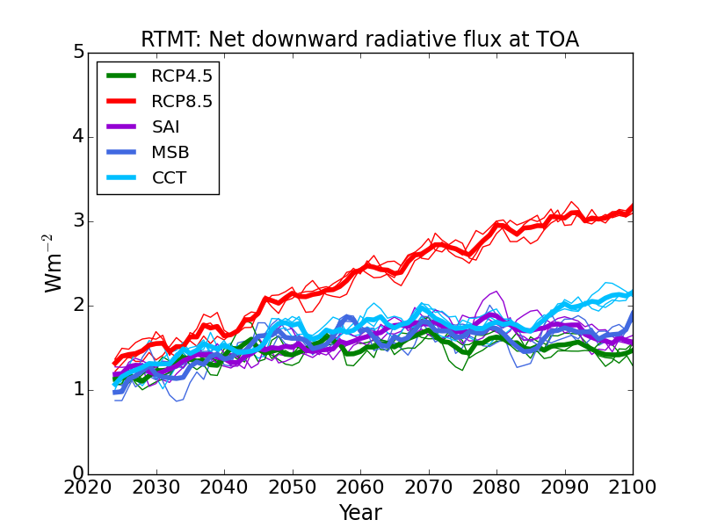
Method
Model details:
NorESM1-ME with interactive biogeochemistry
1.9x2.5° lat x lon resolution
26 vertical levels
3 realisations.
SAI: prescribed aerosol layer.
MSB: increased emissions of accumulation mode sea salt aerosols ±45° lat.
CCT: increase in ice crystal fall speed for T < -38°C.

Slide 4
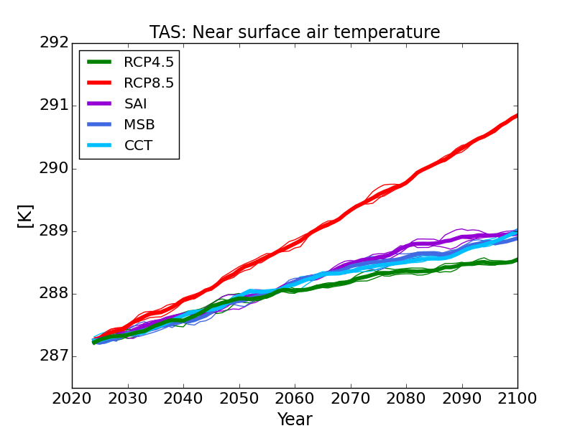
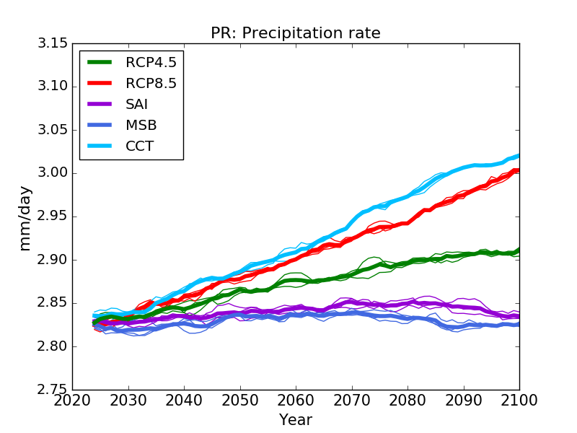
Global 5 year running mean
Near surface air temperature (K)
Precipitation rate (mm / day)
More latent heat release
SW suppression of precipitation
Remaining heat

Slide 5
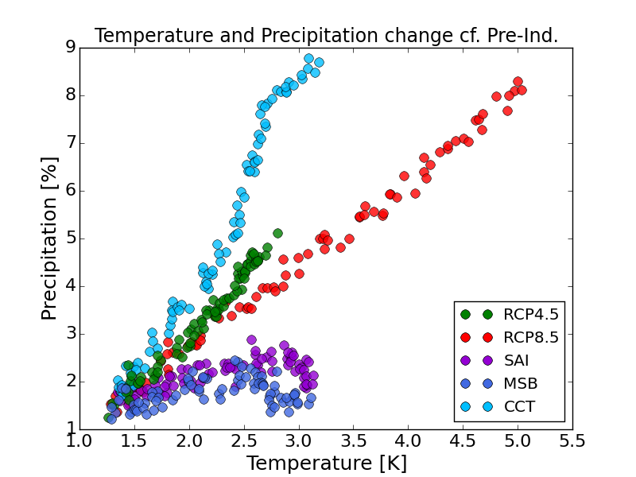
Temperature vs precipitation change from the pre-industrial

Slide 6
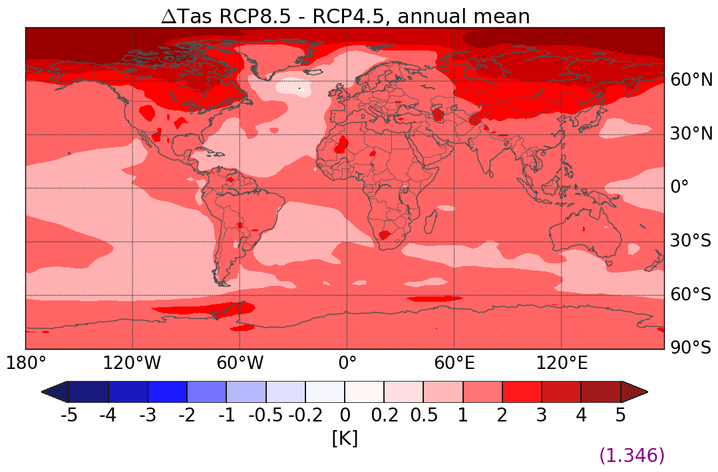
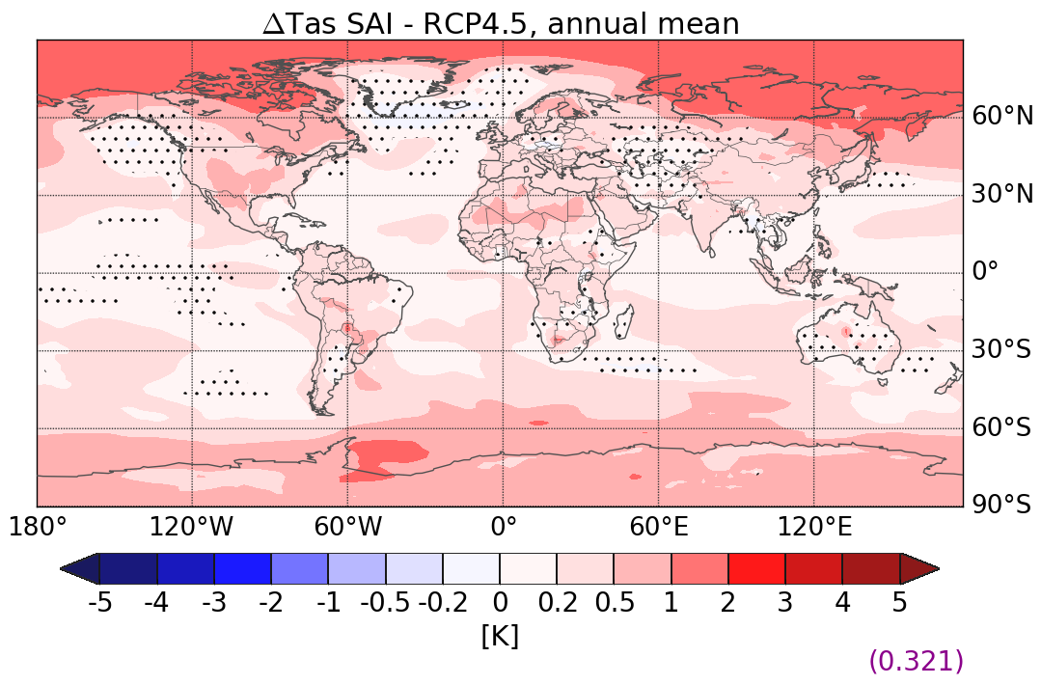
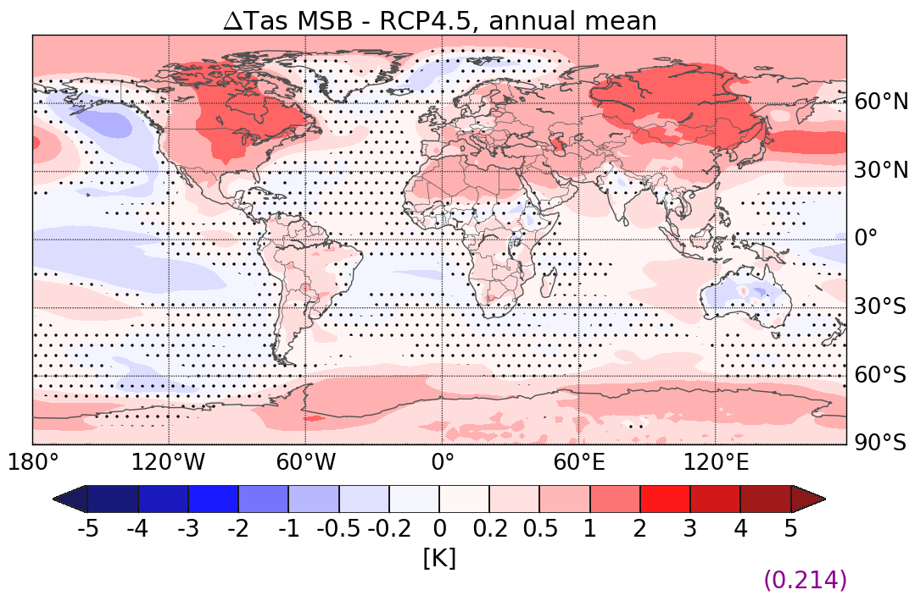
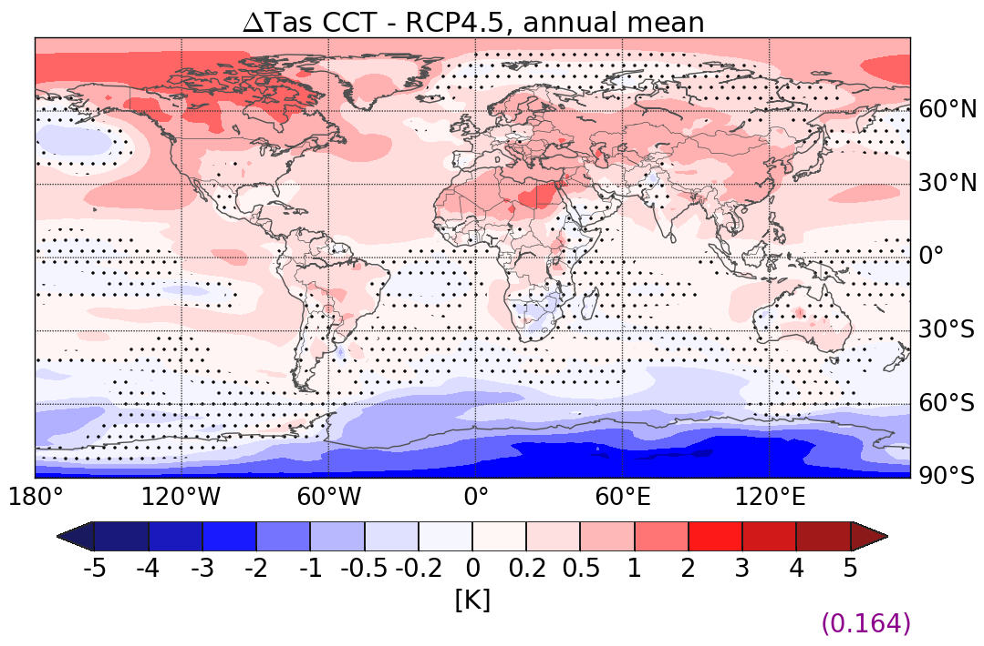
Annual mean temperature change (K)
RCP8.5-RCP4.5
SAI-RCP4.5
Residual Arctic heat
MSB-RCP4.5
CCT-RCP4.5
SH over-cooling
2060 - 2090
Non-significant values

Slide 7
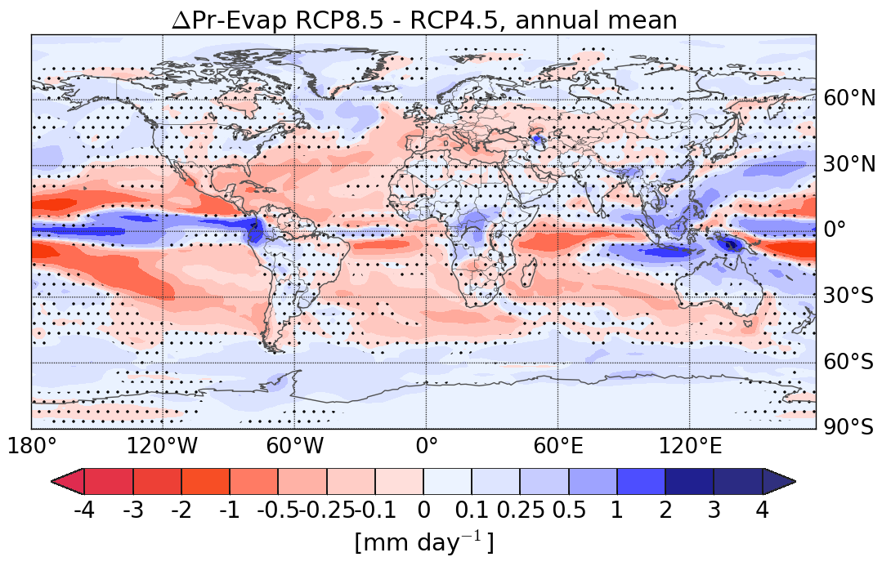
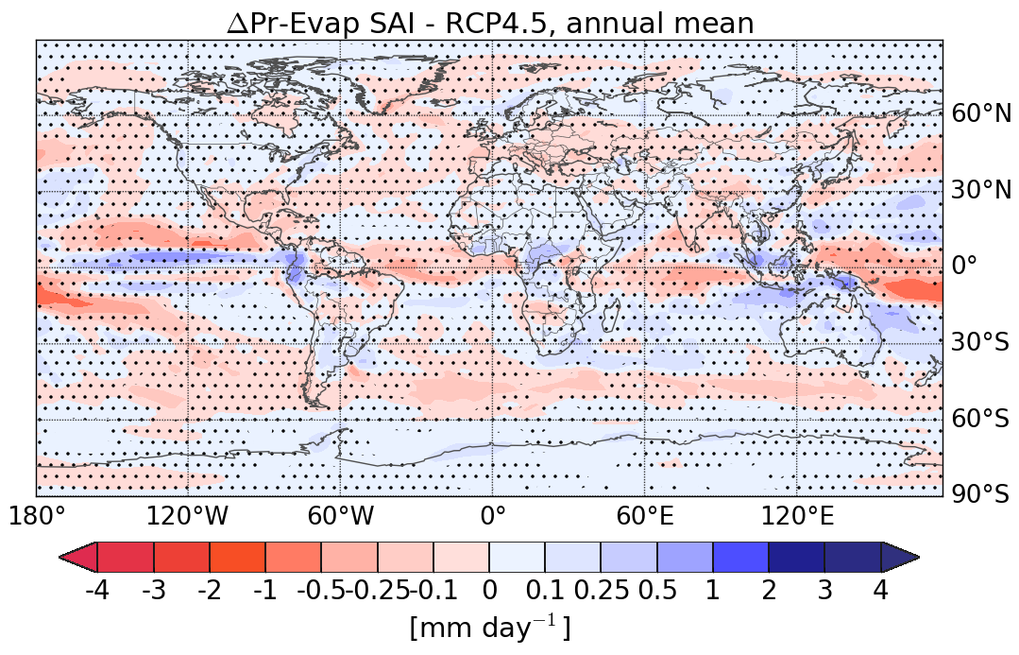
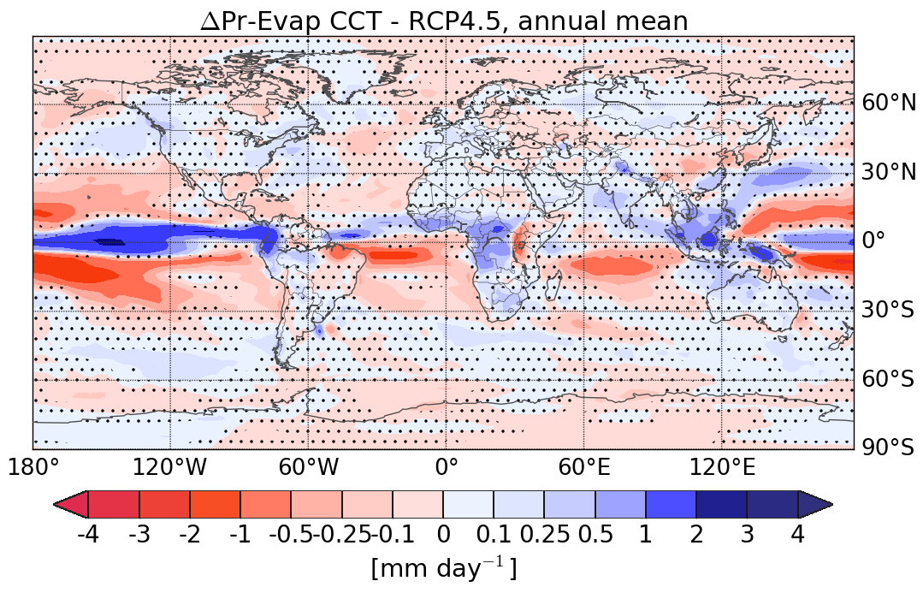
Precipitation – Evaporation (mm/day)
RCP8.5-RCP4.5
SAI-RCP4.5
«Monsoon-like effect»: hydrological cycle intensified over land
Northwards ITCZ shift
MSB-RCP4.5
CCT-RCP4.5
2060 - 2090
Non-significant values

Slide 8
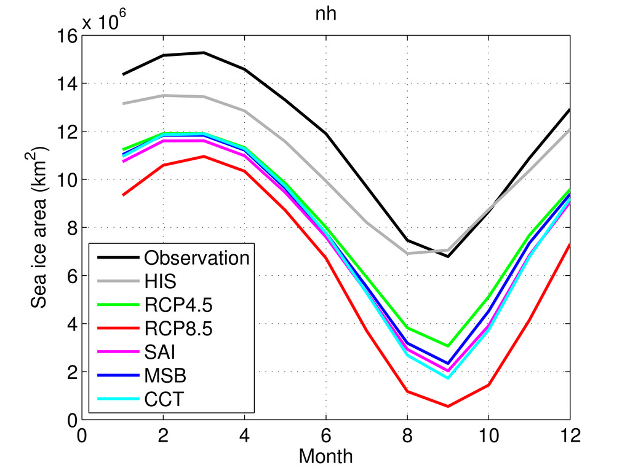
Seasonal cycle of Arctic sea ice area (×10⁶ km²)
Autumn sea ice reduction
2060 - 2090

Slide 9
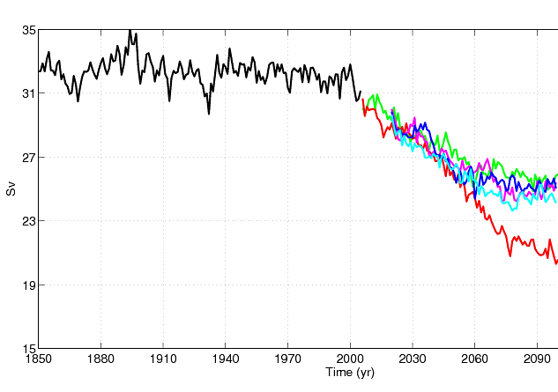
Atlantic Meridional Overturning Circulation (Sv)
RCP8.5: ~35% decrease in AMOC by 2100.
Radiation Management: weakening reduced to ~ 20%, close to RCP4.5.

Slide 10
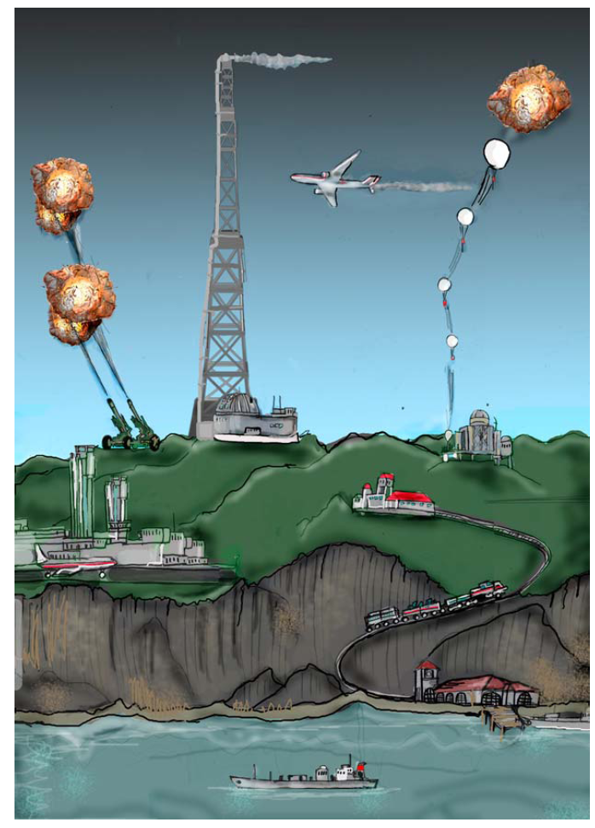
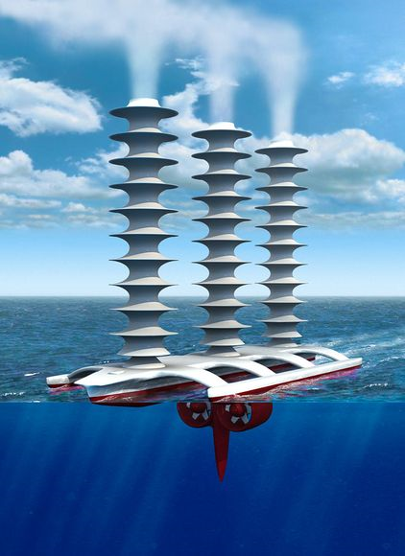
Finally
RM brings climate closer to ‘unperturbed’ state, ameliorates anthropogenic climate changes with varying degree of success.
Different hydroclimate:
less incoming SW → weaker hydrological cycle,
less trapped LW → intensified hydrological cycle.
No substitute for emission reductions, but would possibly contribute to reduce global harm.
Aerosol – cloud – climate uncertainties

Slide 11
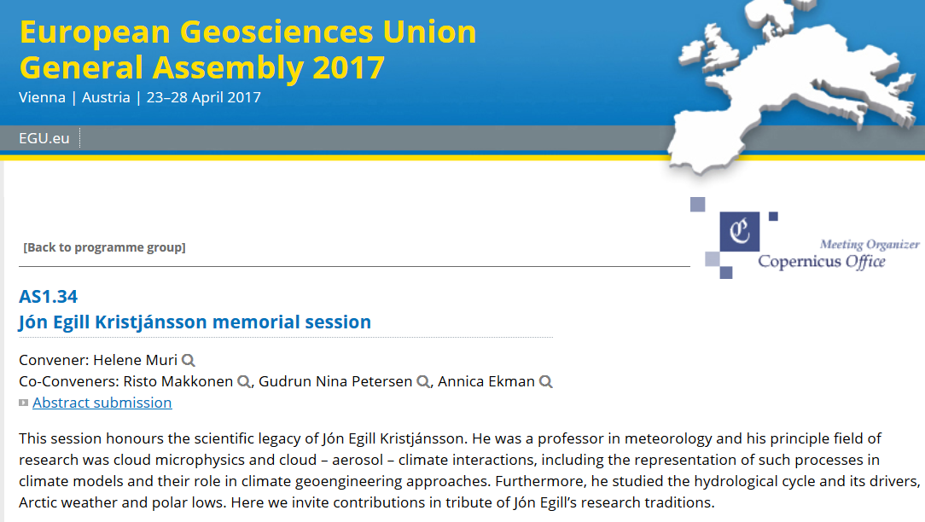
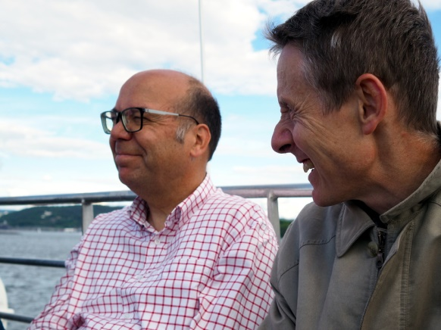
Submit your abstract now! Deadline 11. January

Slide 13
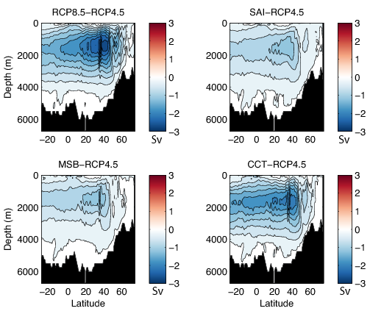
Atlantic Meridional Overturning Circulation

Slide 14
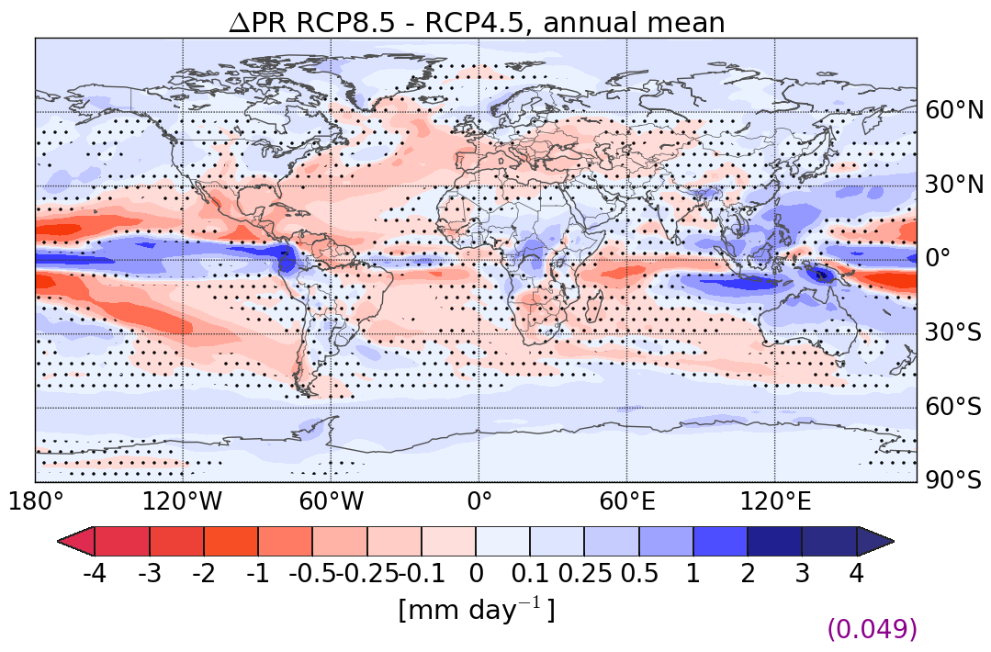
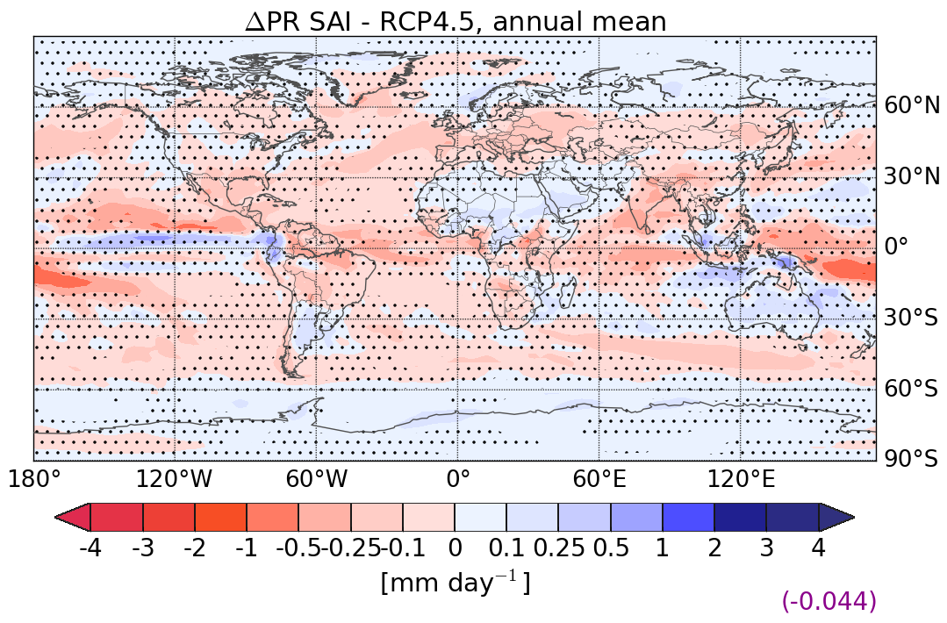
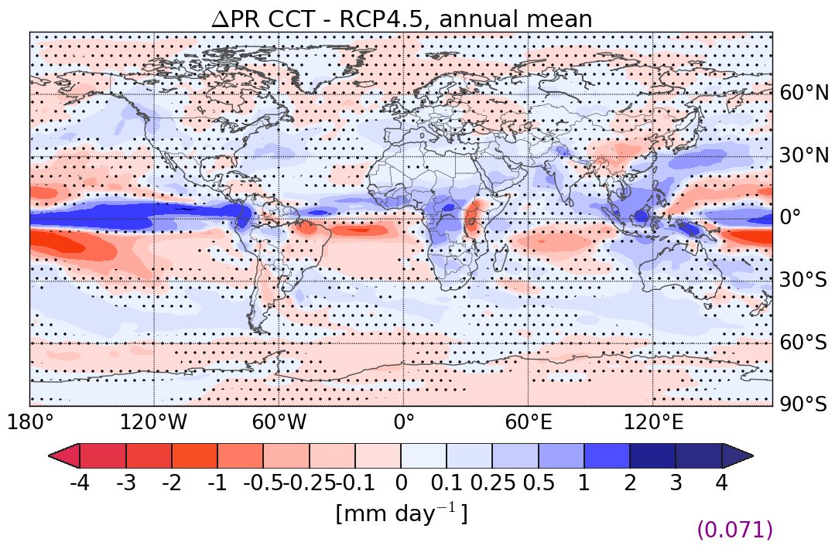
Annual mean precipitation rate difference (mm / day)
a)
b)
c)
d)

Slide 15
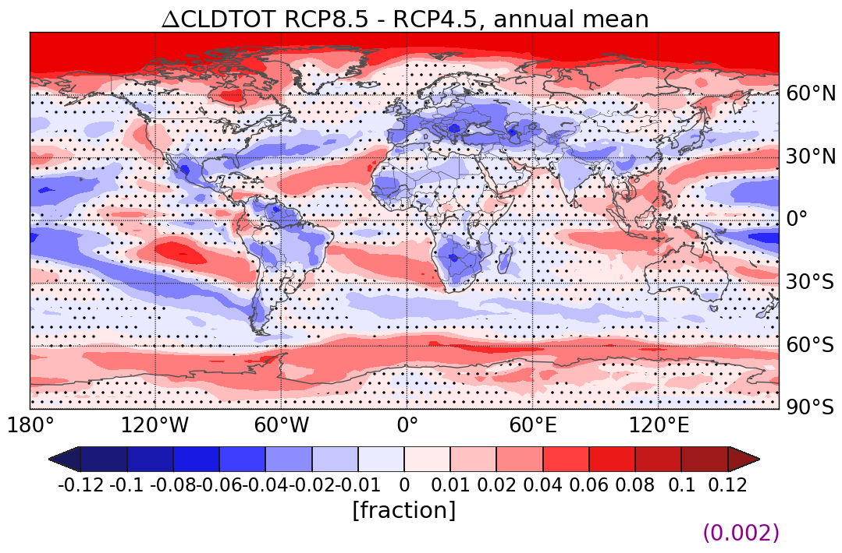
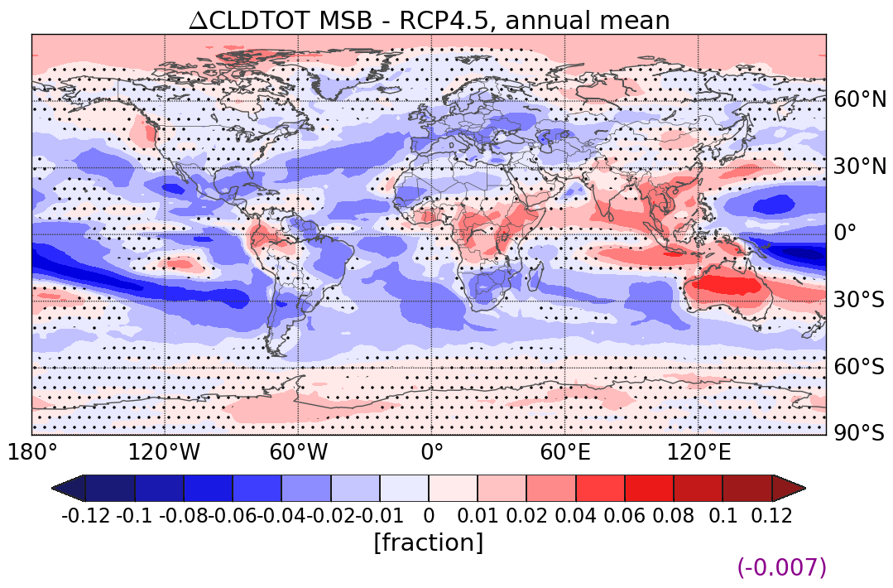
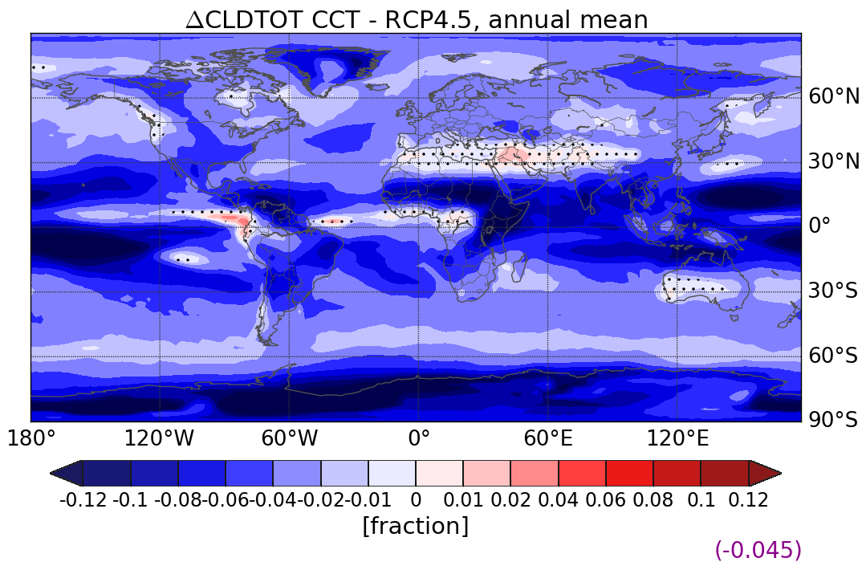
total cloud cover

Slide 16
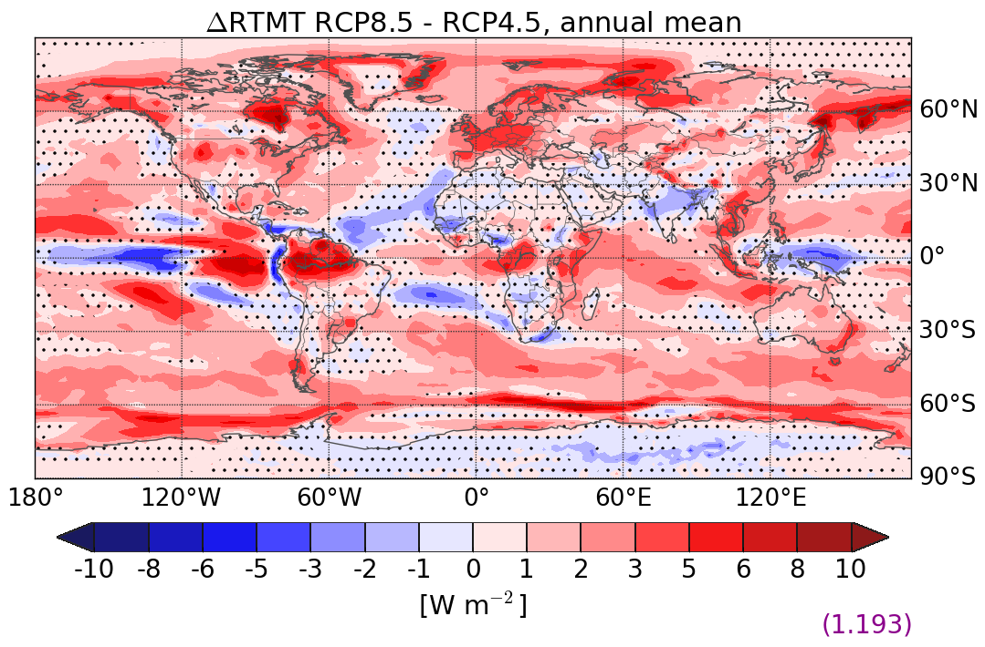
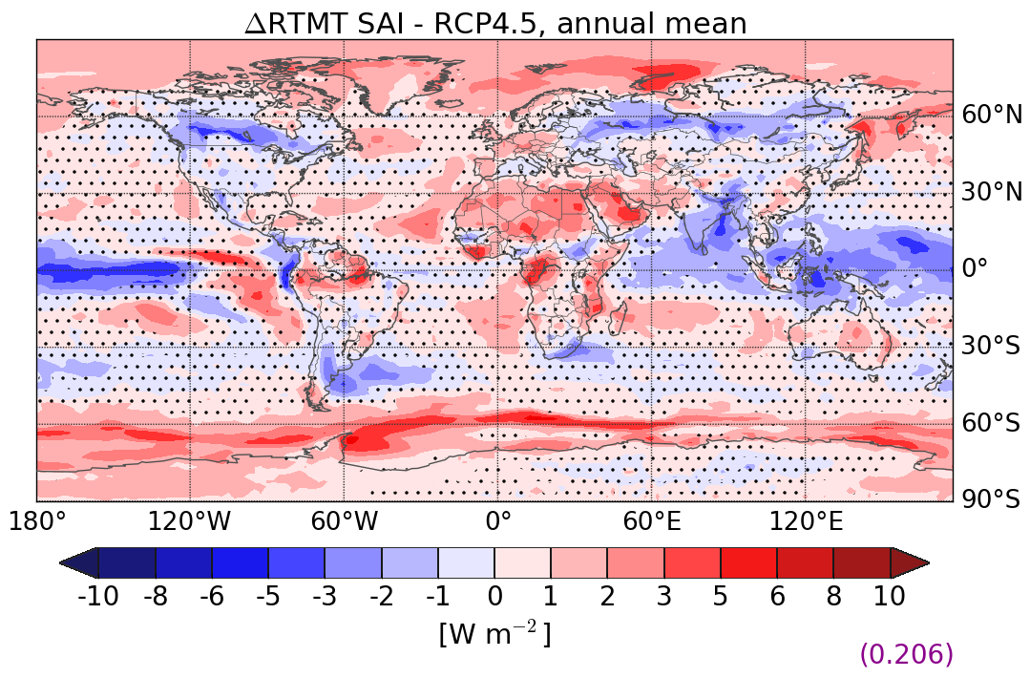
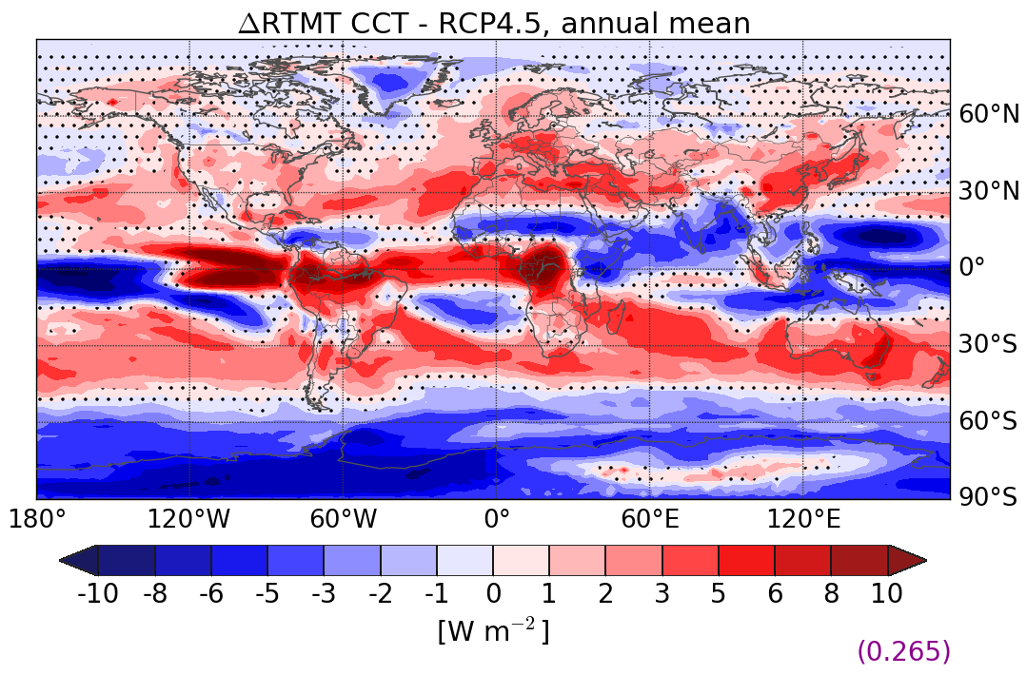
Radiative flux imbalance at TOA [Wm⁻²]
a)
b)
c)
d)

Slide 17
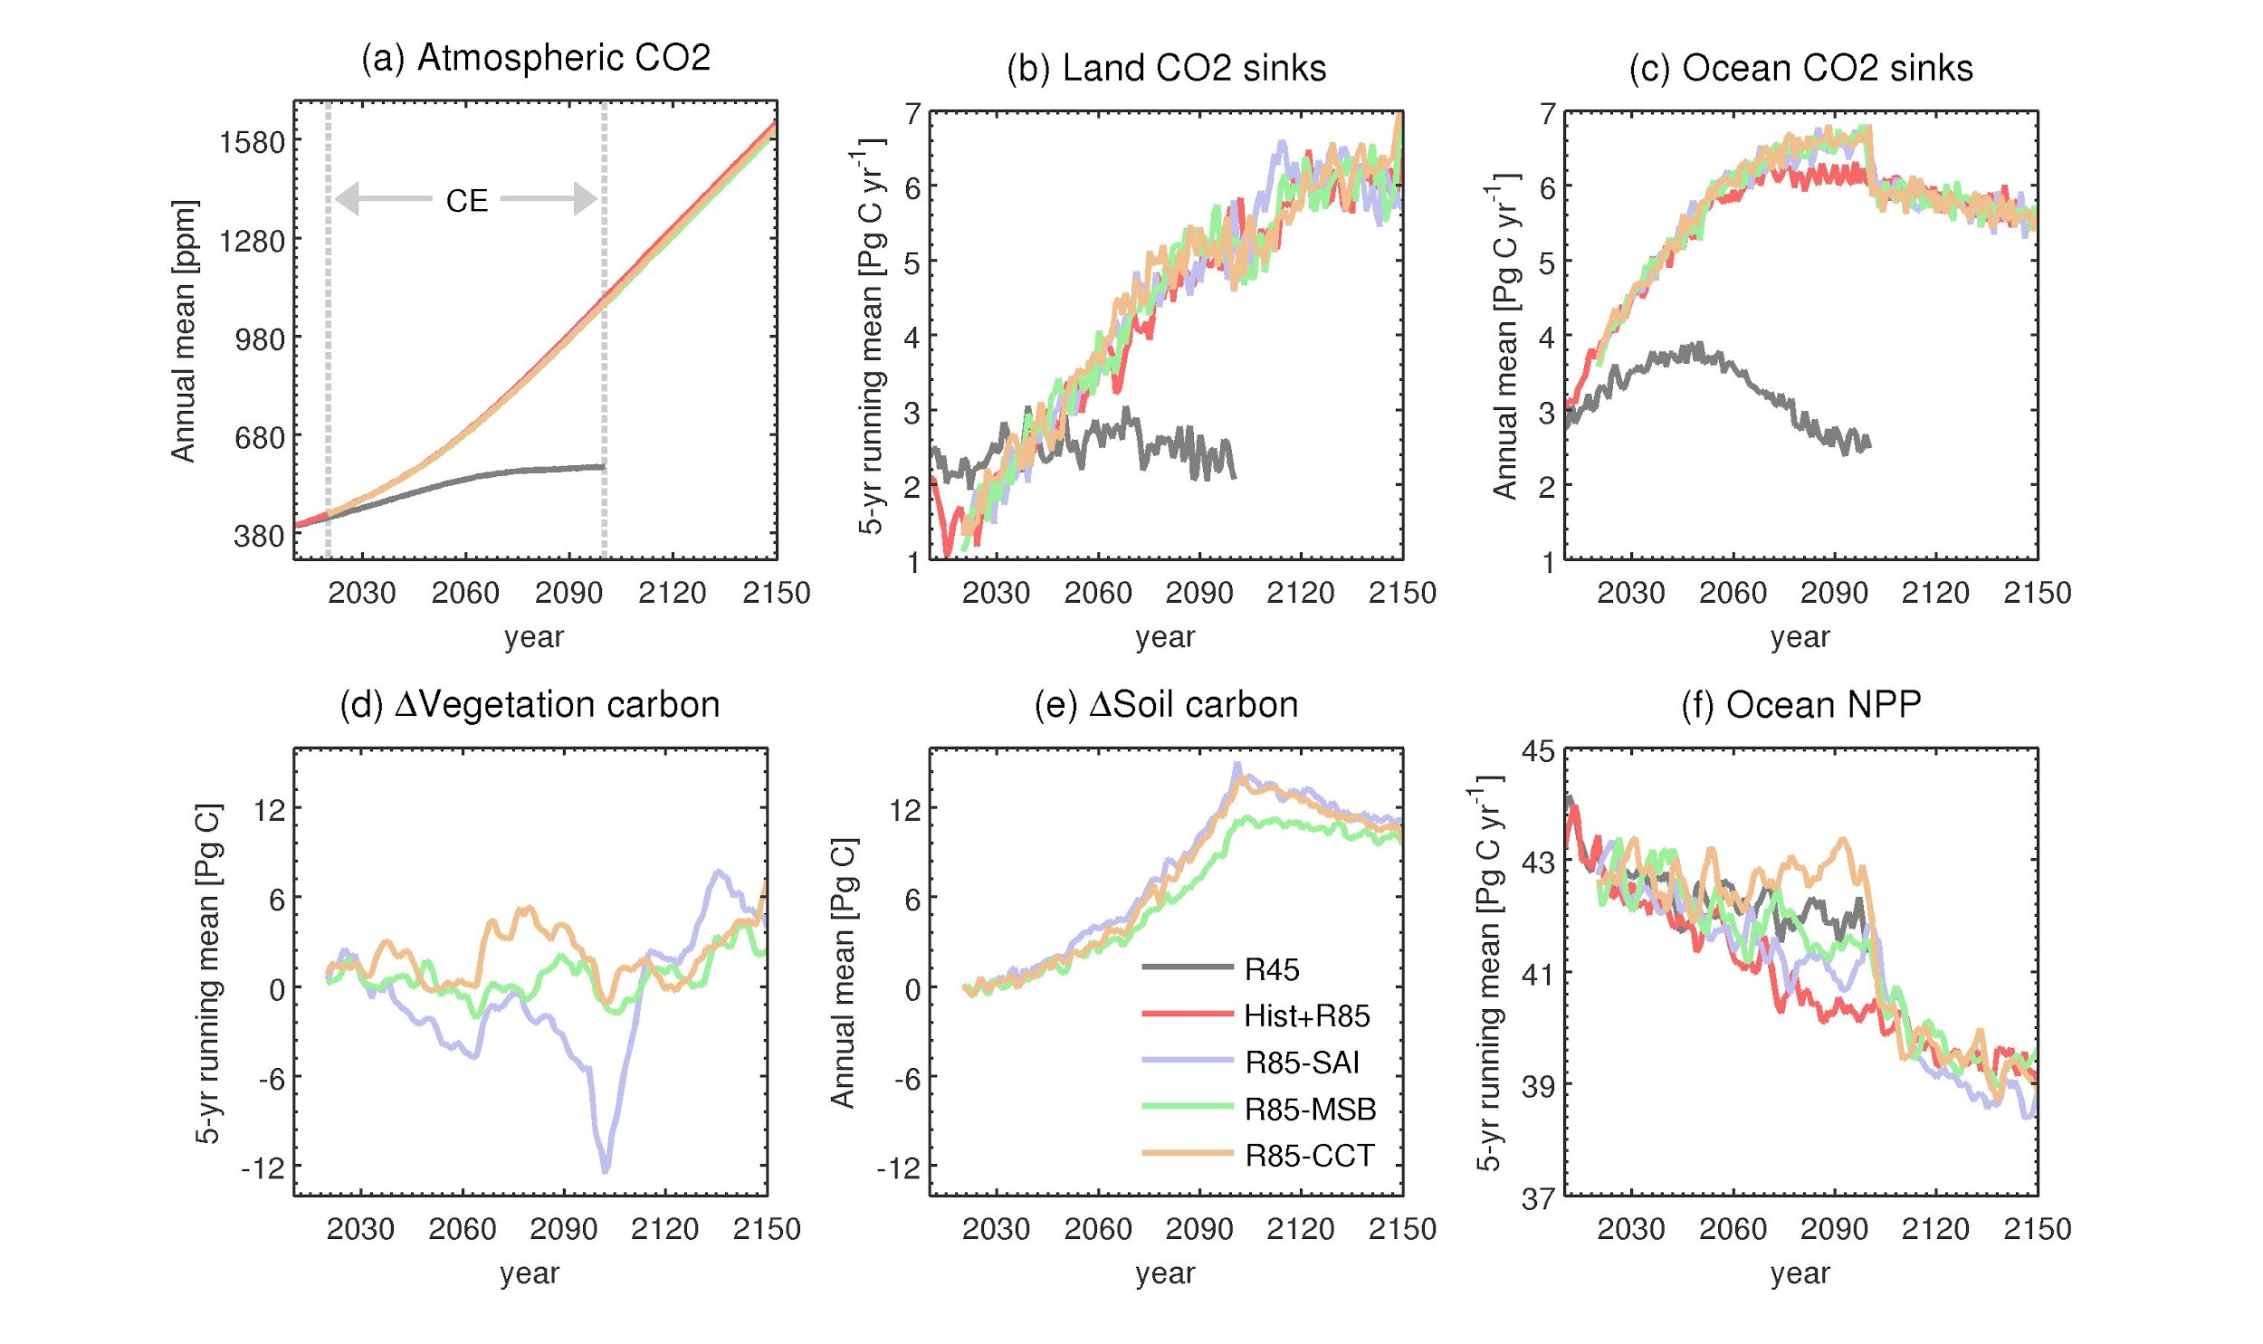

Slide 18
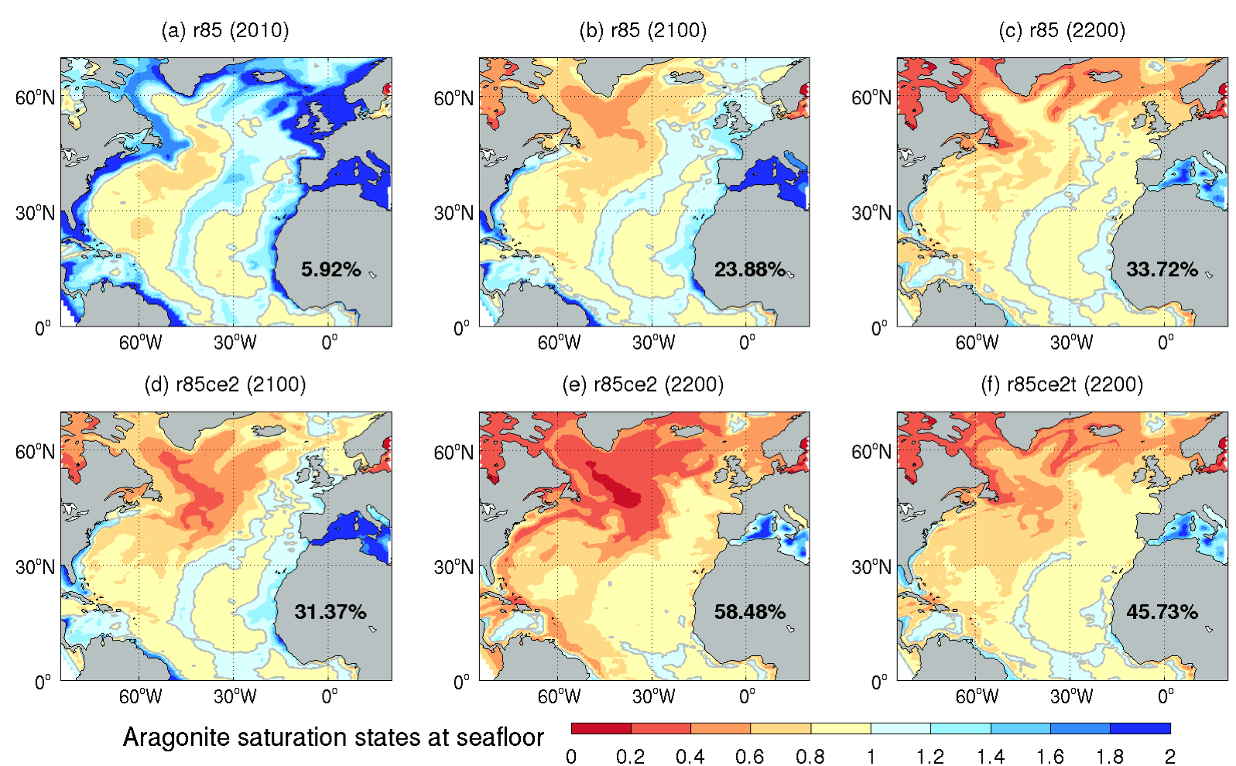
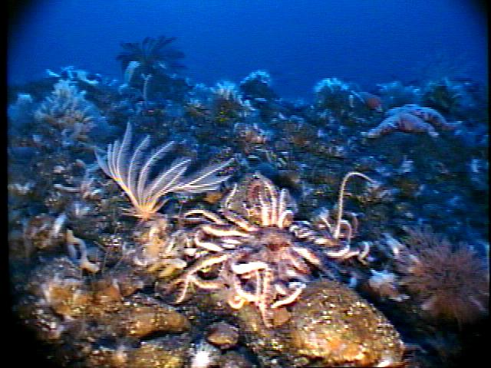
Ocean acidification on seafloor
undersaturated
supersaturated

