Slide 1
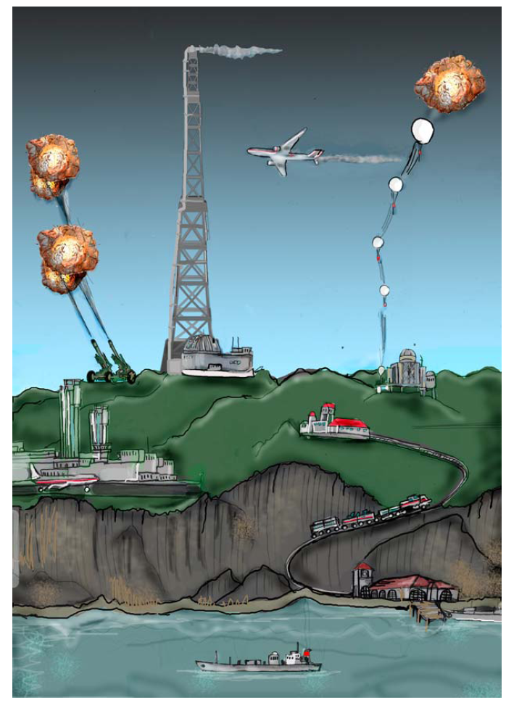

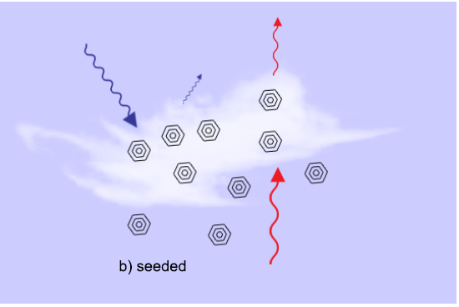




Multi-CE-technique simulations in EXPECT
EXPECT
Alf Grini, Jón Egill Kristjánsson, Siv Lauvset, Helene Muri, Odd Helge Otterå, Michael Schulz, Jerry Tjiputra

Slide 2
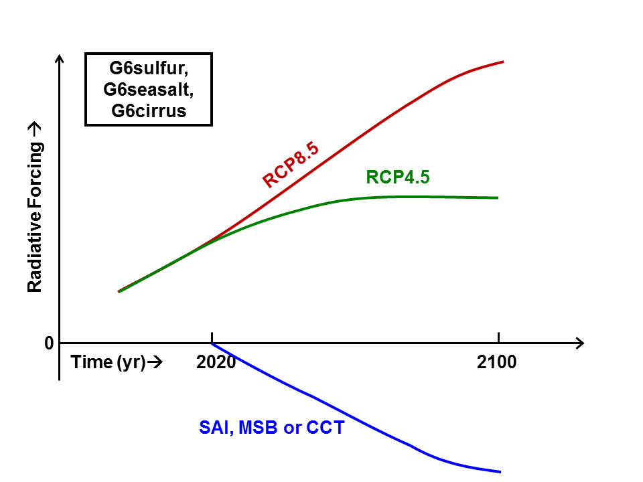
Simulations
Model: NorESM1-ME with interactive biogeochemistry
Target: Transfer from RCP8.5 to RCP4.5 through CE
CE techniques: Stratospheric Aerosol Injections (SAI), Marine Sky Brightening (MSB), Cirrus Cloud Thinning (CCT)
Simulation years: Start in 2020, end in 2100 (or terminate CE in 2100)
RCP8.5
RCP4.5

Slide 3
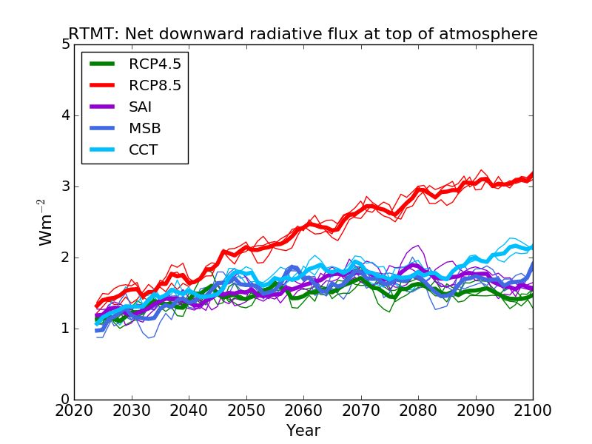
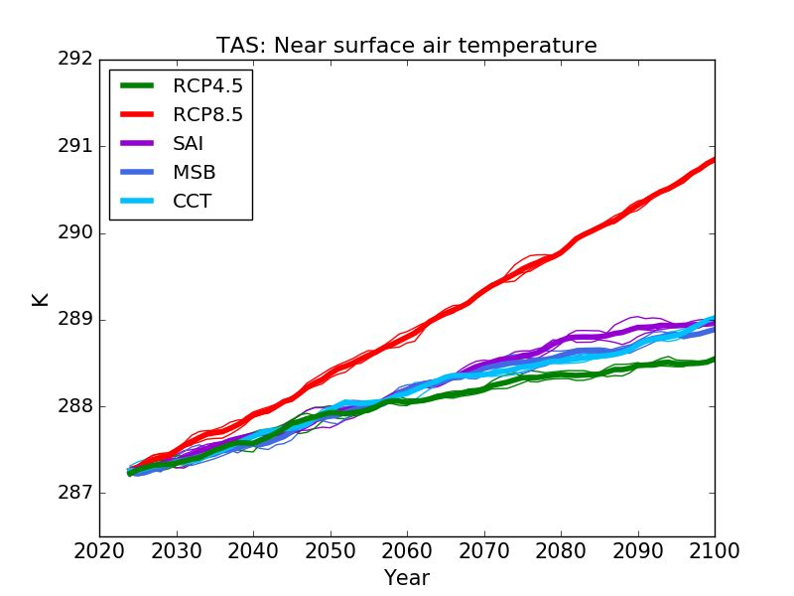
Net Flux at TOA Surface Temperature
Both SAI and MSB successfully simulate transition RCP8.5 →RCP4.5
CCT is unable to reach a -4 W m⁻² radiative forcing at 2100
All three CE techniques are slightly too warm compared to RCP4.5 at 2100

Slide 4
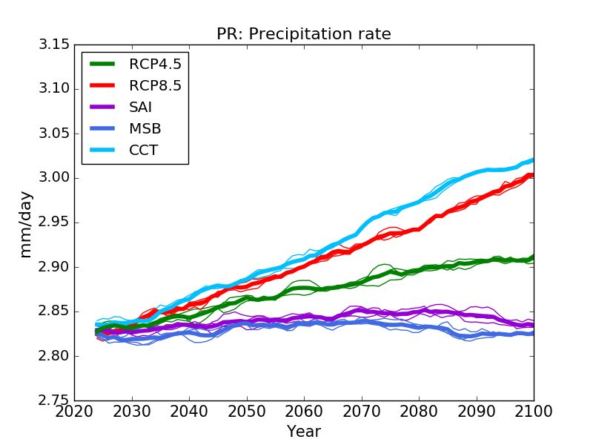
Precipitation Evolution
CCT maintains precipitation at the level of RCP8.5
Both SAI and MSB suppress precipitation, compared to RCP4.5

Slide 5
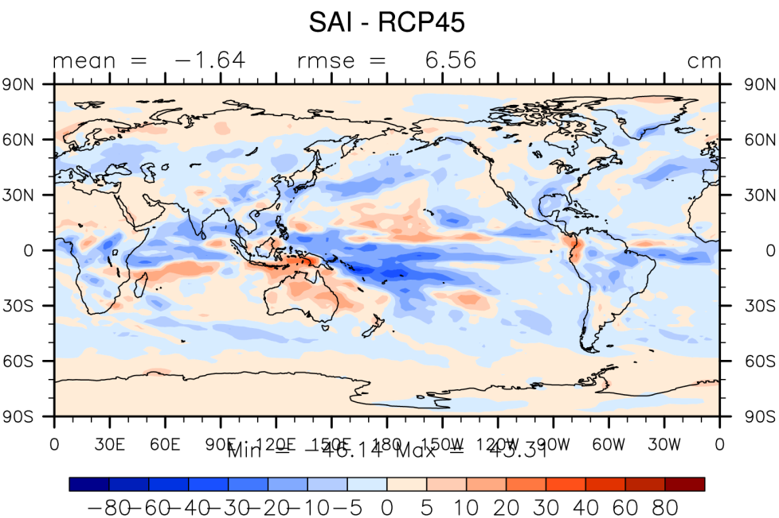
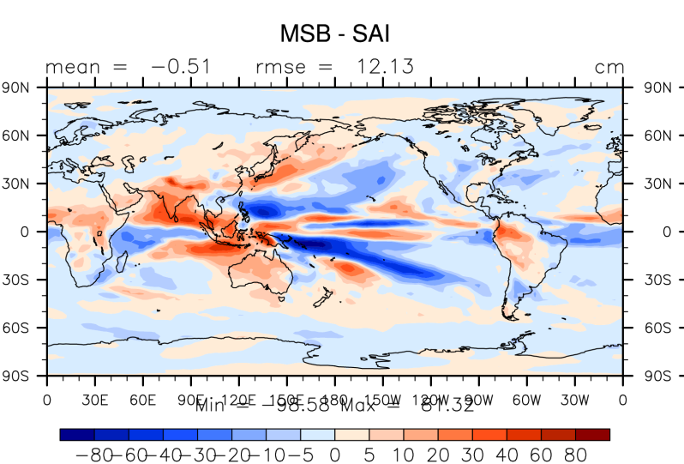
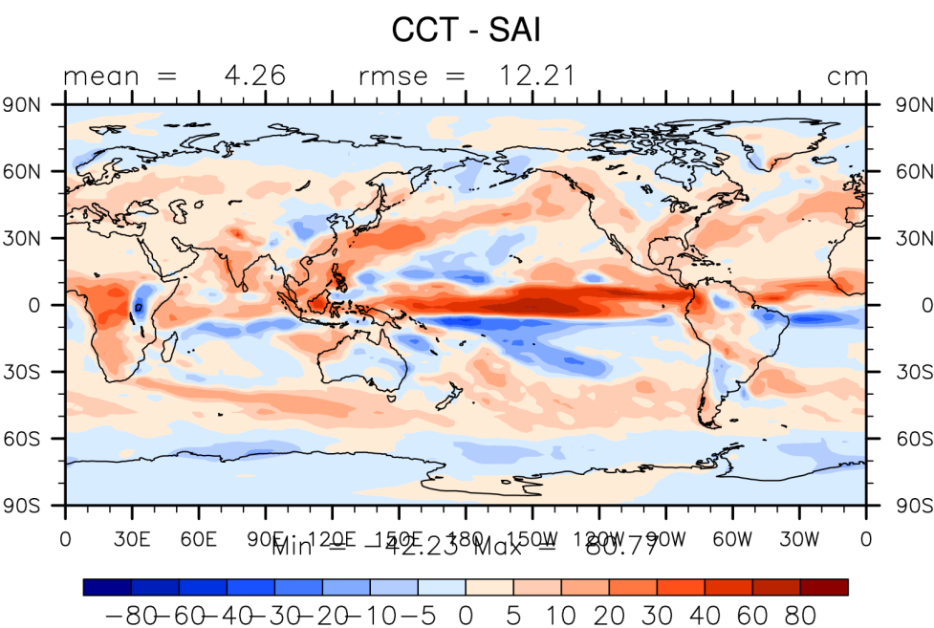
Annual Precipitation in years 2060 - 2089
SAI: Weaker hydrological cycle, due to reduced latent heat flux from the surface
MSB: Enhanced precipitation over low-latitude land regions
CCT: Stronger hydrological cycle + northward shift of ITCZ

Slide 6
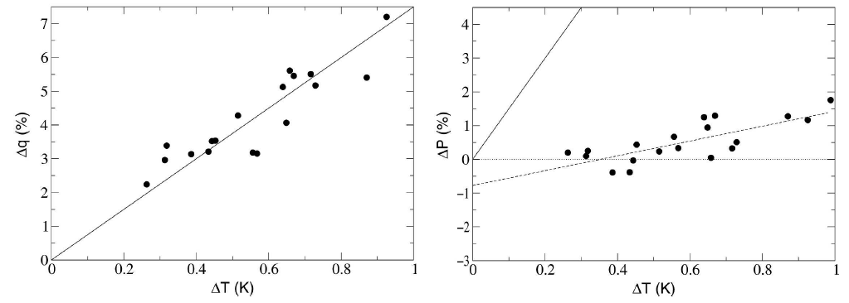
Weakening of hydrological cycle in global warming simulations
Water vapor vs Temperature
Precipitation vs Temperature
7.5% / K
2.2% / K
Held & Soden (2006; J.Climate)

Slide 7
CCT + CO₂-Increase: Enhancement of Hydrological Cycle
Kristjánsson, Muri and Schmidt (2015: GRL)

Slide 8
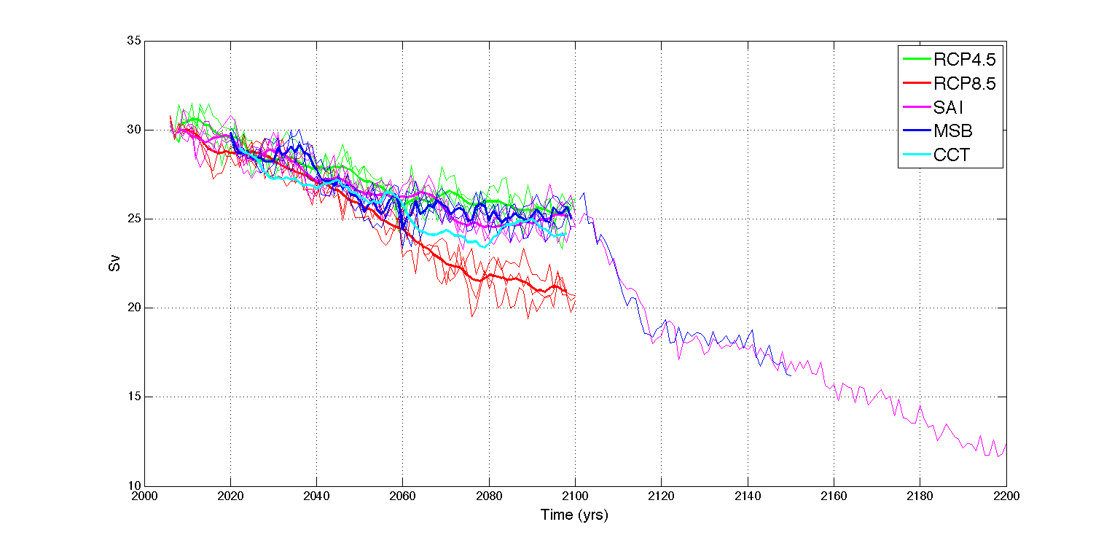
AMOC response to climate engineering
RCP8.5 shows about a 35% decrease in AMOC during the 21st century
In MSB and SAI the weakening is reduced to about 20%, close to RCP4.5
In CCT the AMOC is slightly weaker than the two other CE schemes
Termination induces a drop in AMOC of 7-8 Sv in 15 years!

Slide 9
AMOC response (Sv) to Climate Engineering
RCP8.5 – RCP4.5
SAI – RCP4.5
MSB – RCP4.5
CCT – RCP4.5
AMOC weakened in RCP8.5 and CCT, unchanged in SAI

Slide 10
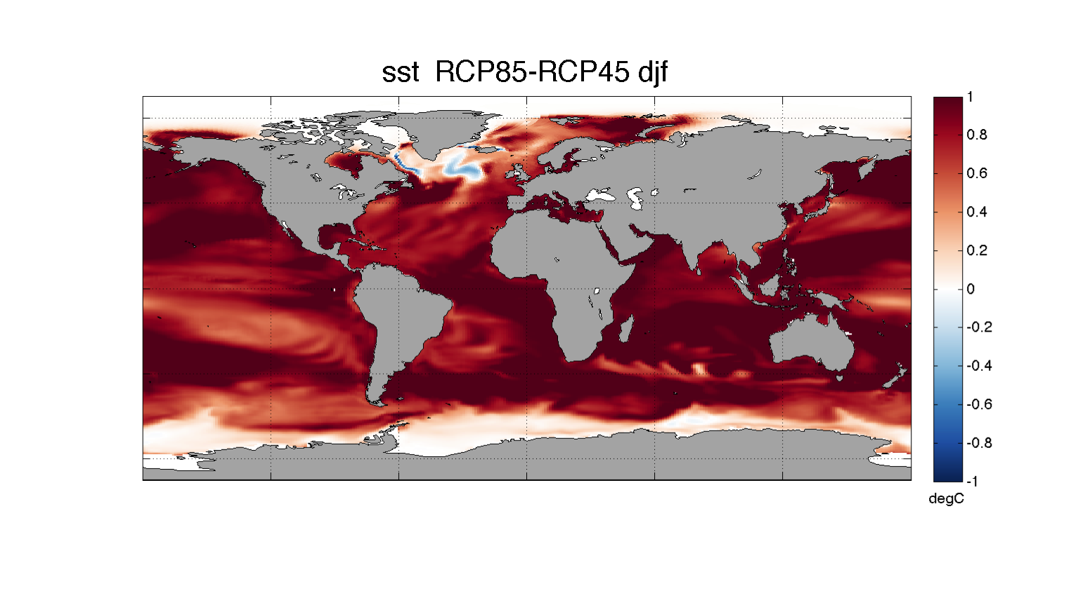
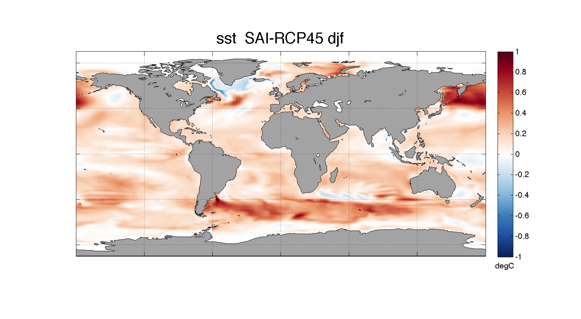
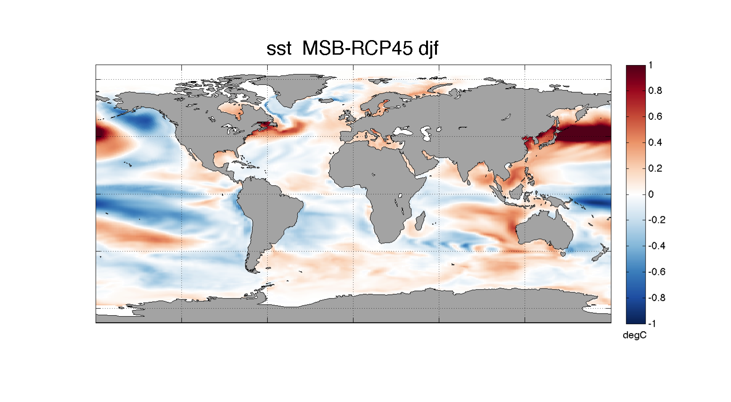
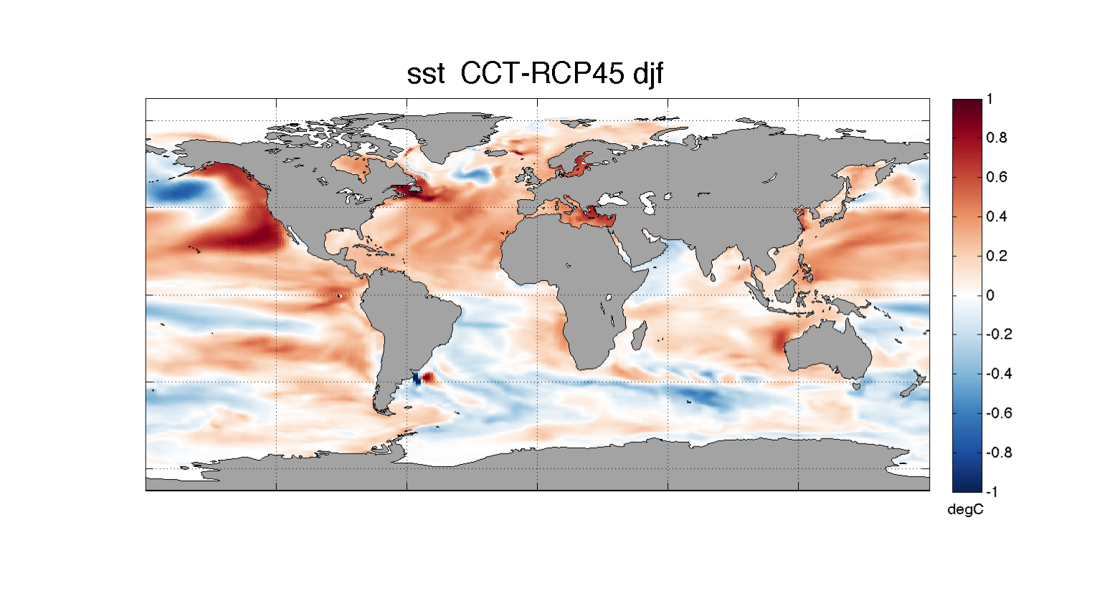
DJF: Global SST response to various CE schemes
Maps show difference from RCP4.5 for 2060-2089

Slide 11
Changes in PDO variability: Second EOF over NP region
Region:
20-65N
120E-100W

Slide 12
Changes in PDO variability: PCs
PC2
The PDO-indices (PC2) suggest that PDO variability is suppressed in MSB case, but enhanced in the CCT case

Slide 13
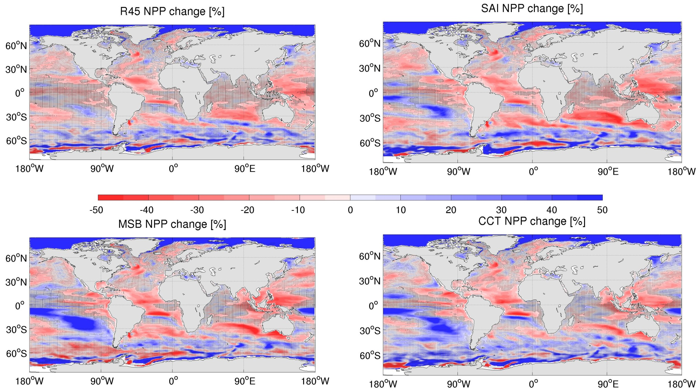
Ocean primary production response to SRMs
Changes [%] of NPP at end of 21st century relative to present-day
Less cloud
Less stratification
Sea-ice

Slide 14
Preliminary findings
Both SAI and MSB succeed in meeting the target; CCT has a slight positive residual warming
In SAI and MSB, Precip is below that of RCP4.5
In CCT Precip is above that of RCP8.5
Reduced AMOC (~30 Sv) in RCP8.5 compared to RCP4.5.
  SAI and MSB have AMOCs close to RCP4.5
  In CCT, AMOC is still similar to that of RCP8.5
In MSB PDO variability is slightly damped, while in CCT it is enhanced

Slide 15

Thank you!
http://expected.bitbucket.org

Slide 16
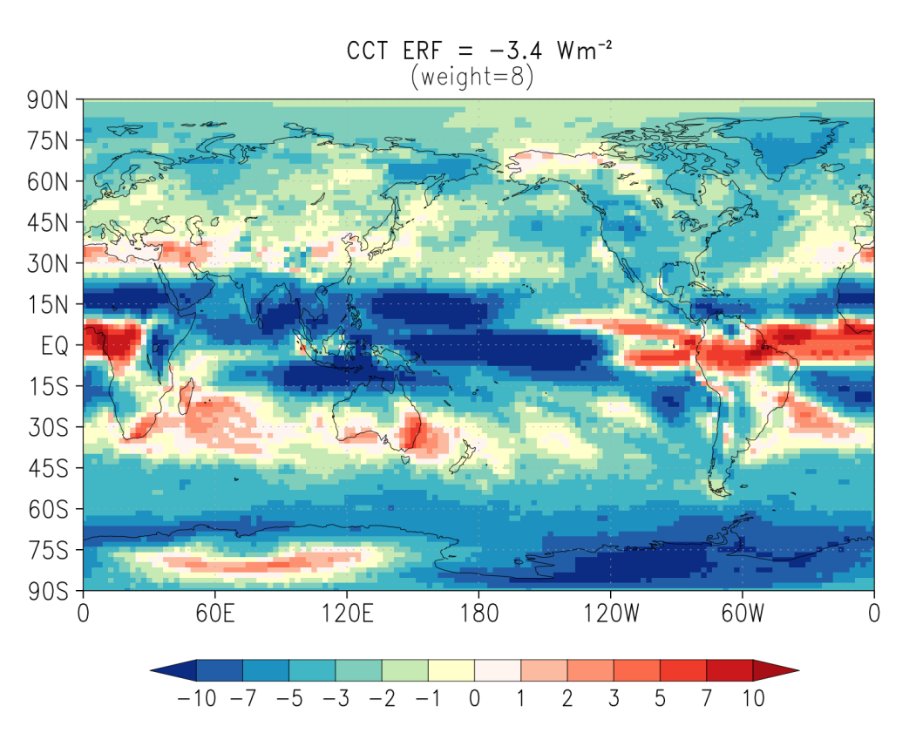
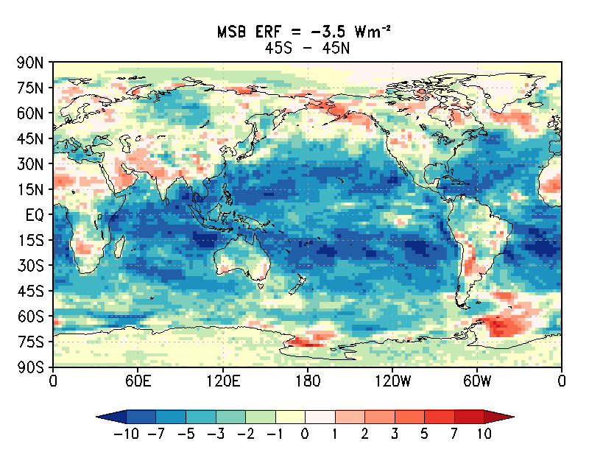
Radiative Forcing in CCT and MSB
(ERF in fixed-SST simulations)

Slide 17
Ocean Heat Content (0 – 750 m)
The MSB and SAI scenarios almost fully reach the RCP4.5 scenario
CCT scenario reduces about 2/3 of the difference between RCP8.5 and RCP4.5
Note the rapid increase in OHC upon termination of CE

Slide 18
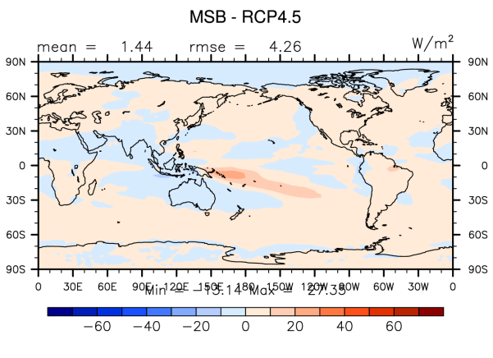
MSB: SWCF
Due to climate feedbacks, Short Wave Cloud Forcing is reduced in MSB
(cf. Lars Ahlm’s talk on G4sea-salt)

