Slide 1
Kvalobs QC2d3: spatial control (at the observation time resolution)

Slide 2
Plan of Qc2
QC2: Raingauge measurements control
QC2d2: Time series adaptation (filling in?)
QC2d3: Spatial control
QC2d4: Statistics control: control of time series with neighbouring stations (?)

Slide 3
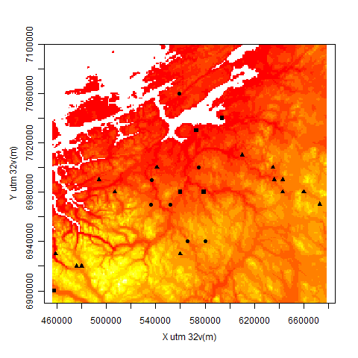
Case studies
A hourly raingauges network located over the Rissa radar area,
28 stations, five years (2006-2010)
Due to permanent zero values in the time series, raingauges named 9580 and 63420 are evinced.
The dataset has been provided by three different stakeholders. Nonetheless, these 3 dataset are homogeneous
Rem: similarities with different kind of measurement tools within an institute
Presence of heterogeneous rainfall processes: elevation from 40 to 913 m

Slide 4
Spatial control: highlighting spatial anomalies
Anomalies: values that are not in agreement with the remaining part of the data.
- Non-erroneous measurements related to different processes (rain: stratiform, convective, orographic, rare (extreme?) event, ….)
- Erroneous measurements (outliers values) coming from a defective device, bad data transmission,…etc
Objective: A semi-automatic spatial control algorithm has to address both types of anomalies.
Rem: Human will always have the last words. Decision makers have to evaluate and distinguish between possible reasons for the observed anomalies.
Rem: the idea here is not to interpolate/predict values but highlighting some anomalous in order to evince some values or to give some more information on the method to use for a better interpolation/prediction. No prior model

Slide 5
Two kinds of spatial control: climatologic, «at each time step»
Climatologic:
Objective: Semi- automatic detection of recurrent anomalies (erroneous values, heterogeneous processes)
At each time step:
Objective: Semi-automatic detection of non-recurrente anomalies (erroneous values, rare (extreme) event)

Slide 6
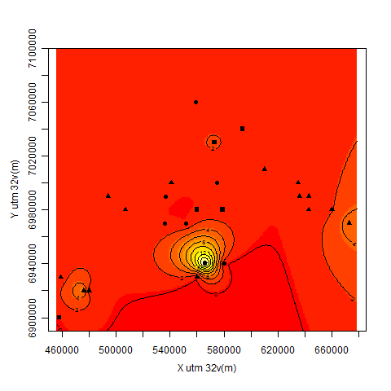
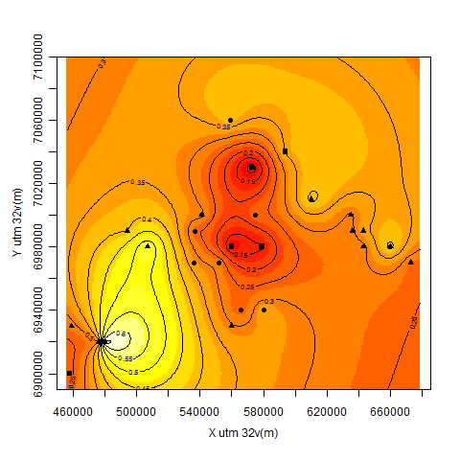
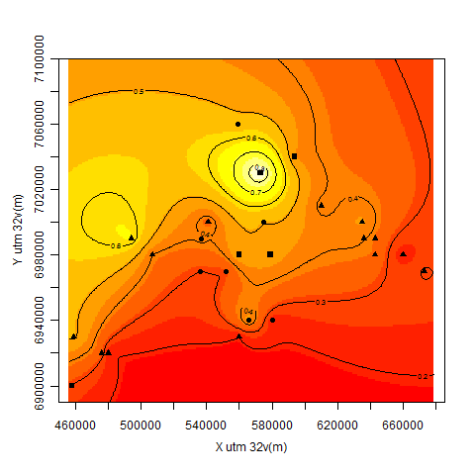
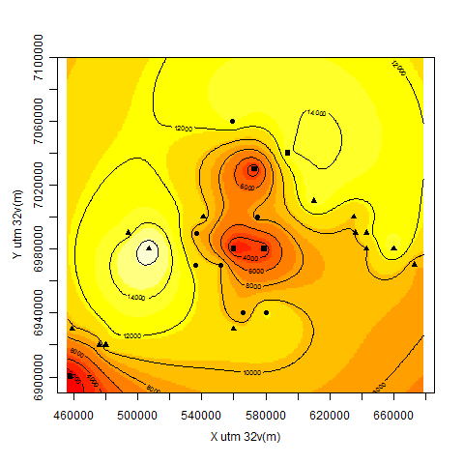
Climatologic spatial control
a- Highlighting anomalies using climatological statistic characterics and a Self-Organizing Mapping (SOM) method:
Non-zero rainfall variance
Rainfall indicator mean
Non-zero rainfall mean
Presence of rain (0=never, 1= always)
Due to a high rate of missing values,
raingauges named 61630, 67280, 67560, and 68860
have been evinced from the study

Slide 7
Climatologic spatial control
a- Highlighting anomalies using climatological statistic characterics and a Self-Organizing Mapping (SOM) method:
Kohonen mapping:
Previously, «heuristic-manually mapping»:
Group # | NZR var (mm²) R ind mean NZR mean (mm)
1: 9 | 19.34 0.253 0.457
2: 20,24 | 5.725 0.279 0.325
3: 26,28 | 0.661 0.601 0.302
4: 7,10,12,25,27 | 0.814 0.327 0.514
5: 23 | 1.725 0.411 0.259
6: 8,11,13,14,15,16,17,18,19,21,22 | 0.421 0.314 0.340
Group # | NZR var R ind mean NZR mean
1: 9 | very high normal lightly high
2: 20, 23,24 | high normal normal
3: 17,26,28 | normal high normal
4: 7,10,12,25,27 | lightly high normal high
5: 8,11,13,14,15,16,18,19,21,22 | normal normal normal

Slide 8
Climatologic spatial control
a- Highlighting anomalies using climatological statistic characterics and a Self-Organizing Mapping (SOM) method:
=>Automatic mapping with three statistic characteristics: ok
KOHONEN | HEURISTIC-MANUALLY
1: 9 | 1: 9
2: 20,24 | 2: 20, 23,24
3: 26,28 | 3: 17,26,28
4: 7,10,12,25,27 | 4: 7,10,12,25,27
5: 23
6: 8,11,13,14,15,16,17,18,19,21,22 | 5: 8,11,13,14,15,16,18,19,21,22

Slide 9
Climatologic spatial control
a- Highlighting anomalies using climatological statistic characterics and a Self-Organizing Mapping (SOM) method:
But:
1- are we able to differentiate a defective station from climatological characteristics related to one/several/superimposed heterogeneous processes (in space and in time)?
Ideally (utopically), only one rainfall process, in order to detect erroneous statistic characteristics.
-In space: coastal, in the valley, orographic…
-In time: according to the atmospheric conditions: stratiform, convective,… (Using weather classification)
Levene test: homoscedasticity
filled square: group 1,
filled circle: group 2,
filled triangle: group 3,
empty circle: group 4,
empty square: group 5,
empty triangle: group6
Group Nzr | Rainfall indicator
p-value significance level | p-value significance level
1: - - | - -
2: 0.2206537 <80% | 0.9038534 <10%
3: 0.9584924 <5% | 0.9707996 <5%
4: 0.9998181 <1% | 0.9998788 <1%
5: 0.9999984 <1% | 1 <1%
6: 0.9998812 <1% | 0.9997923 <1%

Slide 10
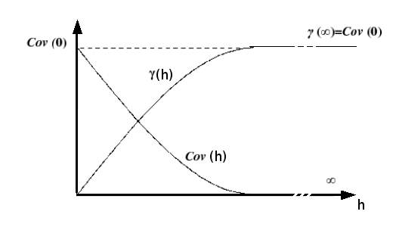
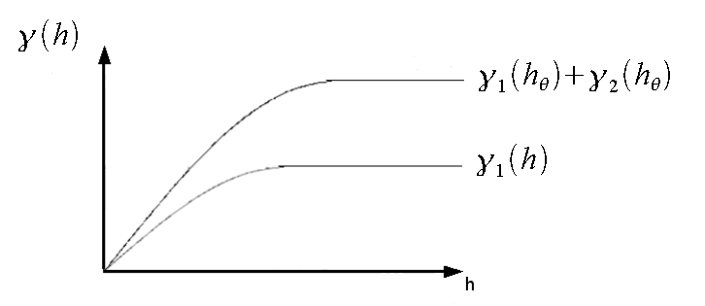
Climatologic spatial control
b- Highligting anomalies using climatological spatial structures (geostatistics)
Using variogram cloud: variance between two point in space: spatial information
Looking at the Nzr variogram, Rain indicator variogram, Transition variogram
Filtering heterogeneous process:
Rem:
-heterogeneous process might be due to a temporal shift of one or several rain time series
-a second structure might be the result of one or several defective stations
This method enables to filter but doesn’t give any information on the origin of the values. We miss the group 5 and 6.

Slide 11
Climatologic spatial control
-SOM and geostatistics help to highlight some stations: erroneous or heterogeneous processes
-Adding weather classification
-Gathering SOM and geostatistics

Slide 12
«At each time step» spatial control
Ref:
Shekhar et al. 2003, A Unified Approach to Detecting Spatial Outliers, GeoInformatica
->SOM, clustering,spatial, stochastic,…
Fournier, Furrer, 2005, Automatic Mapping in the Presence of Substitutive Errors, A Robust Kriging Approach, Applied GIS
->Kriging an unknow (but stationary) process with erroneous values

Slide 13
«At each time step» spatial control
D1-comparison
C- our improved spatial data at time t2
B- nowcasting at time t2
D2- after building new past data set:
extreme analysis, IDF-Areal
Geostat, spde, kalman filter…
Uncertainty…
time
A- our improved spatial data at time t1
or not merged data:
- radar from one side
- raingauges on the other side
numerical model at time t1

