Slide 1

Downscaling of the EMEP model using uEMEP: where scales meet
Bruce Rolstad Denby, Peter Wind, Hilde Fagerli, Michael Gauss, Matthieu Pommier, Erik van der Swaluw

Slide 2
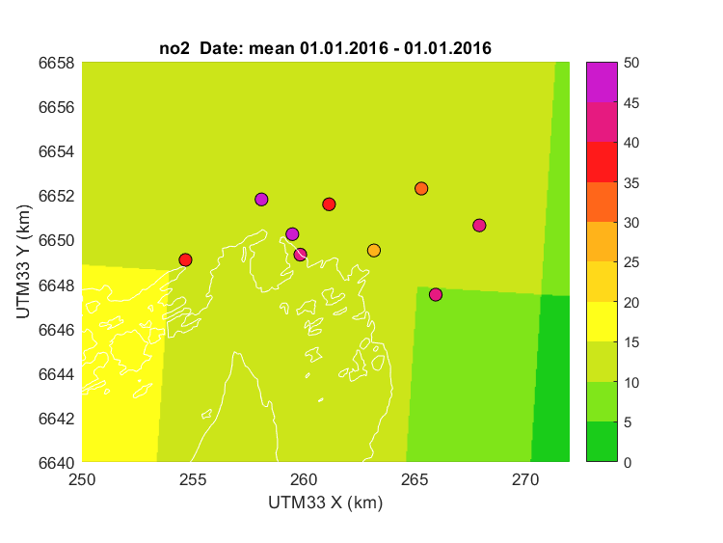
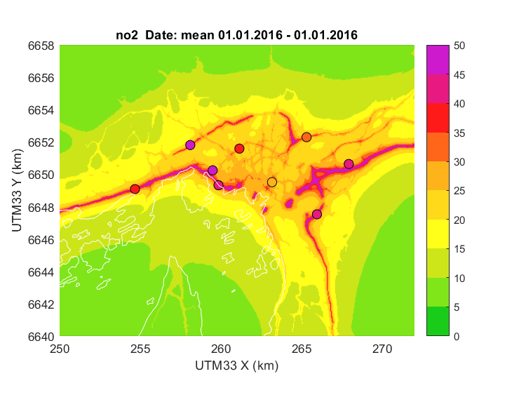
Results
Oslo annual mean NO₂ uEMEP (50 m)
Oslo annual mean NO₂ EMEP (0.1º)

Slide 3
Overview
Much time and effort has been put into the development of regional scale modelling
These models now span many scales, e.g. EMEP is used on the global scale and down to 1 - 2 km (EMEP4UK, EMEP4NO)
Even so, these models cannot resolve local near source gradients (e.g. roads) and cannot be validated by stations near to sources
However, it is possible to cover large regions at high resolution using downscaling or redistribution techniques built into, or appended to, the regional models
Such methods are often referred to as kernel techniques as they redistribute high resolution proxy or emission data based on a moving kernel (really just a Gaussian dispersion model)
Application of these methods reveal the discrepancies between local and regional emission inventory methods
In order to span all scales in future modelling then these emission discrepancies need to be removed

Slide 4
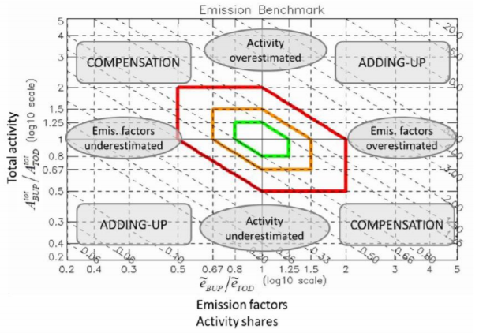
Recent activities in kernel downscaling
Theobold et al. (2016) 1 km sub-grid within EMEP 50 km but did not account for local or non-local contributions
Maiheu et al. (2017) European wide kernel downscaling (125 m) for traffic emissions using Chimere (Presentation Stijn Janssen on Friday)
Sherpa city. European wide user interface (in development) using kernel downscaling and Chimere
FAIRMODE emission comparison maps have shown discrepancies across Europe in top down and bottom up emissions (Enrico Pisoni and Susana Lopez-Aparicio presentations Tuesday)
… and uEMEP
Theobald, M. R., sub-grid model for improving the spatial resolution of air quality modelling at a European scale, GSimpson, D., and Vieno, M.: A eoscientific Model Development Discussions, 2016, 1–22, doi:10.5194/gmd-2016-160, URL http://www. geosci-model-dev-discuss.net/gmd-2016-160/, 2016.
Improved Methodologies for NO2 Exposure Assessment in the EU (2017) Maiheu Bino, Wouter Lefebvre, Heather Walton, David Dajnak, Stijn Janssen, Martin Williams, Lisa Blyth, Sean Beevers. EC Report no.: 2017/RMA/R/1250. http://ec.europa.eu/environment/air/pdf/NO2%20exposure%20final%20report.pdf

Slide 5


A brief overview kernel downscaling methodology
Local
Use CTM to calculate local grid (ls-uEMEP)
Local
or
Non-local
Determine the local CTM grid by volume integration of the sub-grid
Non-local
Non-local
CTM grid concentration
Remove local CTM grid
Redistribute local CTM grid using sub-grid
Distribution kernel based on Gaussian dispersion
CTM grid emission
Redistribute CTM to sub-grid emission
Dispersion local proxy/emission sub-grid
Non-local
Sub-grid proxy data (activity data)
Add resulting local sub-grid to nonlocal CTM
Bottom up sub-grid emission

Slide 6
Advantages of the kernel methodology
The gridded CTM concentration can be conserved, out of respect for regional modellers
If the removal of the local CTM contribution is properly done then all double counting is avoided
Instead of using CTMs as boundary conditions then local models can be laid seamlessly on top of existing CTMs allowing large regions to be modelled at high resolution
For seamless application then the aggregated CTM grid emissions should be the same as the sub-grid distribution
Only appropriate for non-reactive primary emissions (NO₂ post processing possible)

Slide 7
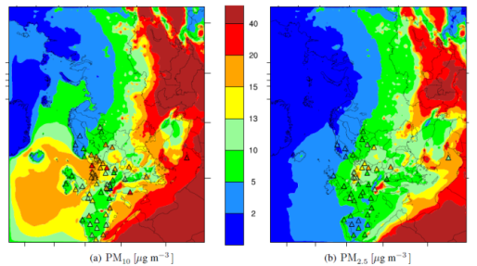
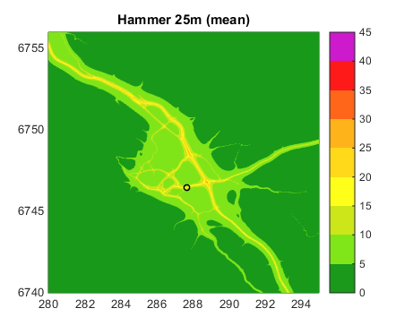
uEMEP
uEMEP (urban EMEP) consists of two parts
A method for calculating the local source contribution of gridded emissions within EMEP has been developed (ls-uEMEP)
A method for downscaling the local source contributions, by redistribution or replacement, to high resolution sub-grids (ds-uEMEP) of ~ 50 m
Can be applied on both hourly and annual data and on all EMEP resolutions (e.g. 0.1º and 2.5 km)

Slide 8
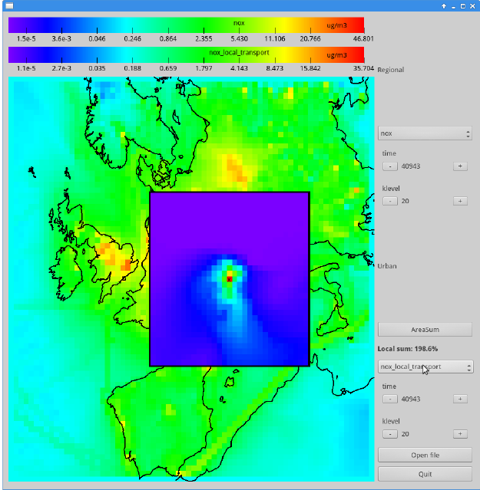
Local source ls-uEMEP
Built into the EMEP model, source concentration fluxes are followed through the model domain to the surrounding grids
With this we know the contribution to each grid from all the neighbouring grids, e.g. 5 x 5 or 20 x 20 surrounding grids
Knowing this we can calculate source contributions to or from the surrounding grids
And/or use this information to downscale only the local source contribution

Slide 9
Example for traffic in Oslo using ls-uEMEP (NO_{x})
2 day forecast average at 2.5 km resolution
Total NO_{x} concentration
Fractional contribution from surrounding grids
Total fraction from all surrounding grids
Total local contribution from traffic

Slide 10
Downscaling ds-uEMEP
Standard Gaussian models are applied on either annual mean or hourly data to disperse sub-grid emissions or proxy data
These are then used to either replace the calculated ls-uEMEP concentration or to redistribute it
Three examples will be shown:
  The sub-grid Gaussian dispersion is volume integrated over the EMEP grid and the sub-grid concentrations are normalised and redistributed at surface level (preserves volume average grid concentration)
  The EMEP gridded emissions are redistributed over the sub-grid emission data and the sub-grid dispersion replaces the EMEP local source contribution (preserves volume average grid concentration only if dispersion and advection is the same)
  Independent emissions are used and the sub-grid dispersion replaces the EMEP local source contribution (does not preserve volume average grid concentrations)

Slide 11
Example for forecast in Oslo using ds-uEMEP (NO_{x})
2 day forecast average at 2.5 km resolution
EMEP NO₂ concentration (2.5 km)
1. Redistribution of ls-uEMEP (100 m)
2. Replaced ls-uEMEP using redistributed EMEP emissions
3. Replaced ls-uEMEP using independent emissions

Slide 12
Example calculations for Norway
NO₂ annual mean

Slide 13
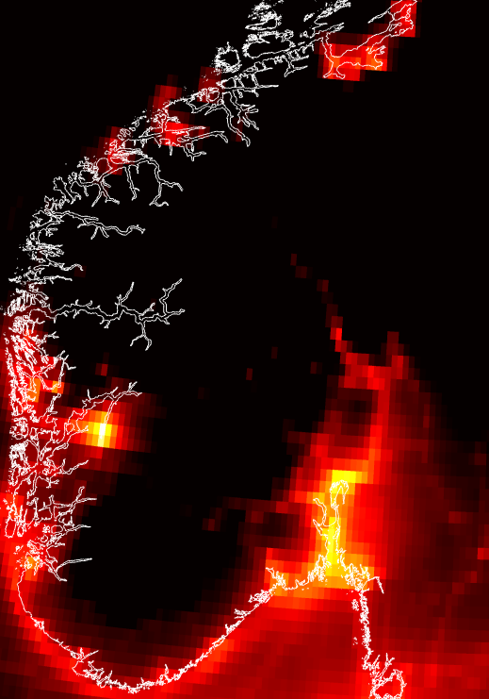
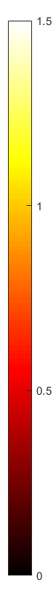
Annual mean NO₂ concentrations for Southern Norway
uEMEP calculation for traffic and shipping at 250 m
EMEP 0.1º
uEMEP 250 m
Scale is logarithmic (log₁₀) from 1 to 30 ug/m³

Slide 14
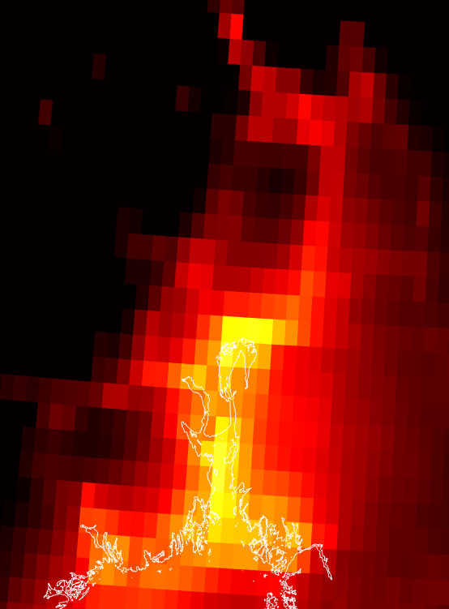

Annual mean NO₂ concentrations for Oslo region
uEMEP calculation for traffic and shipping at 100 m
EMEP 0.1º
uEMEP 100 m
Scale is logarithmic (log₁₀) from 1 to 30 ug/m³

Slide 15
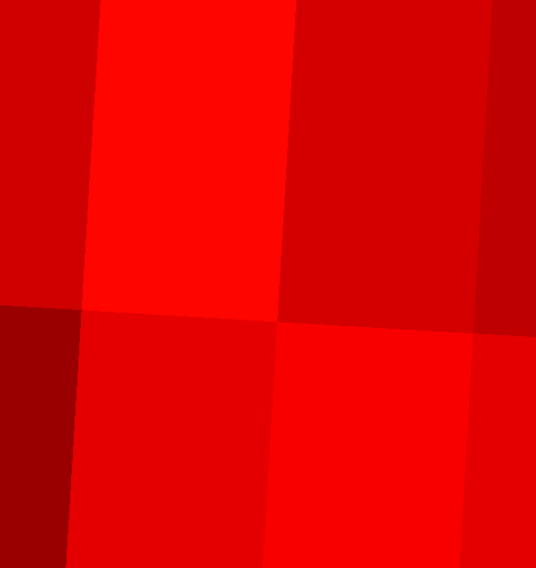
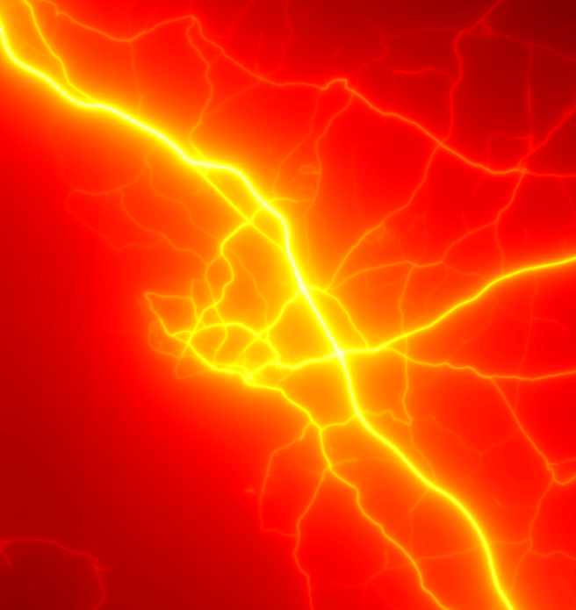
Annual mean NO₂ concentrations for Hamar
uEMEP calculation for traffic and shipping at 25 m
EMEP 0.1º
uEMEP 25 m
Scale is logarithmic (log₁₀) from 1 to 30 ug/m³

Slide 16
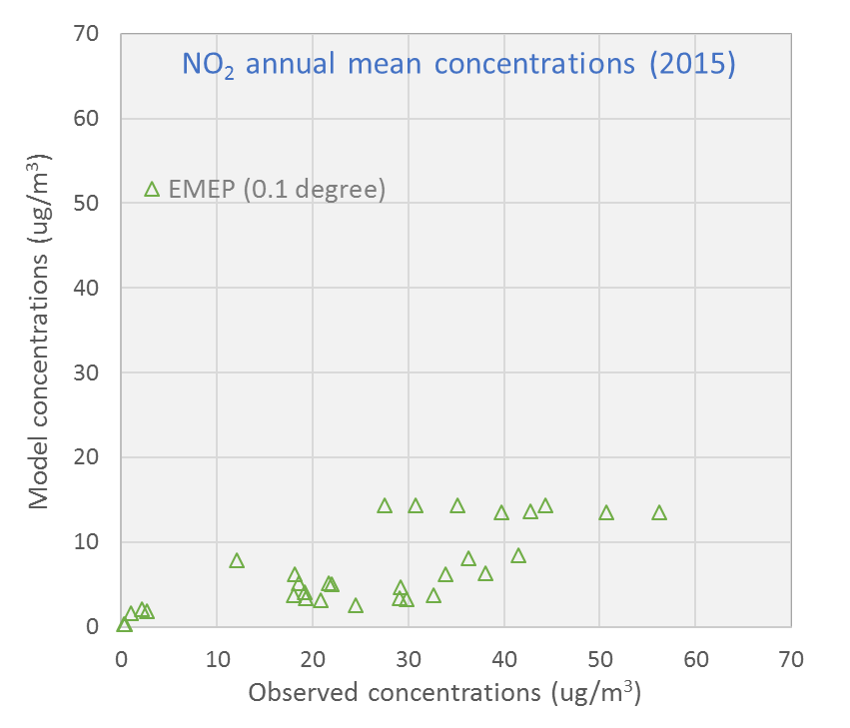
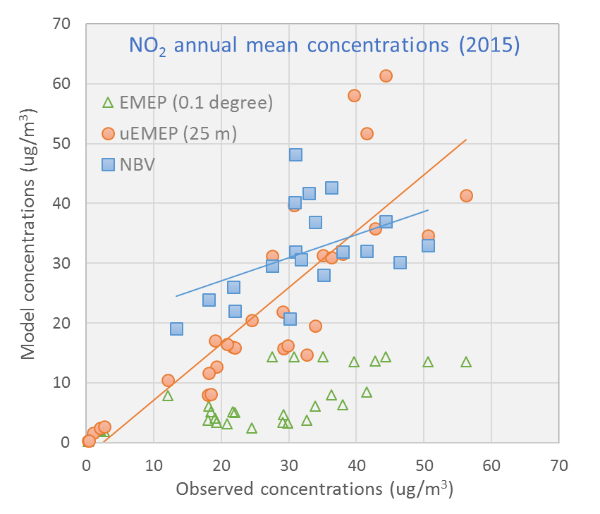
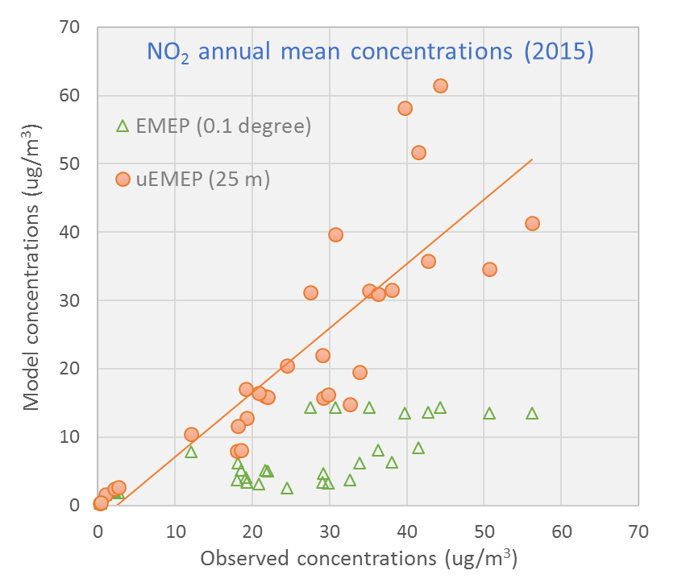
Annual mean NO₂ Airbase stations Norway
Comparison EMEP (0.1º), uEMEP and existing (NBV)

Slide 17
Example in The Netherlands
NH₃ annual mean based on RIVM high resolution emission data

Slide 18
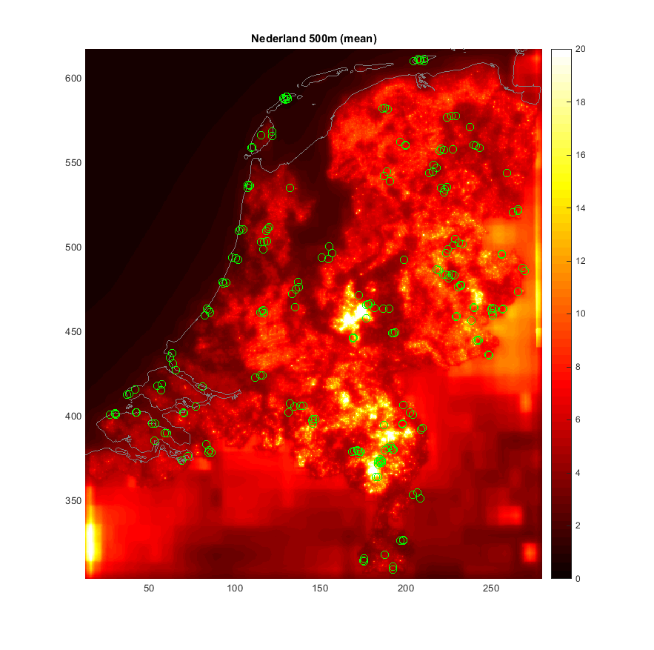
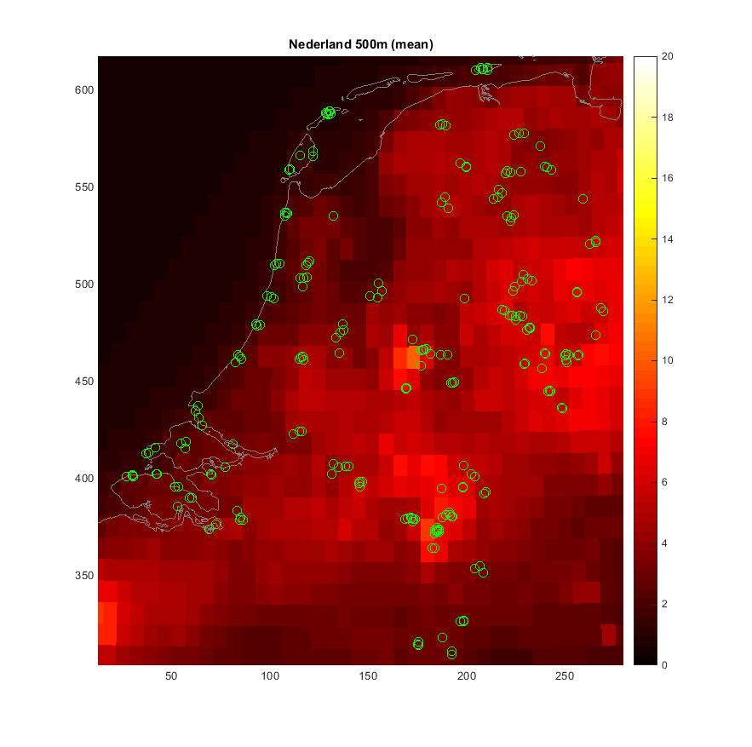
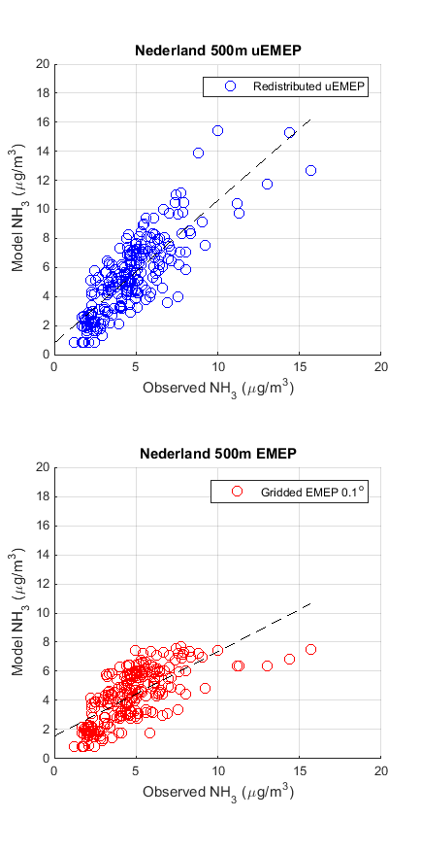
500 m uEMEP with RIVM NH₃ emissions in EMEP
EMEP 0.1º R²=0.43
uEMEP 500 m R²=0.67

Slide 19
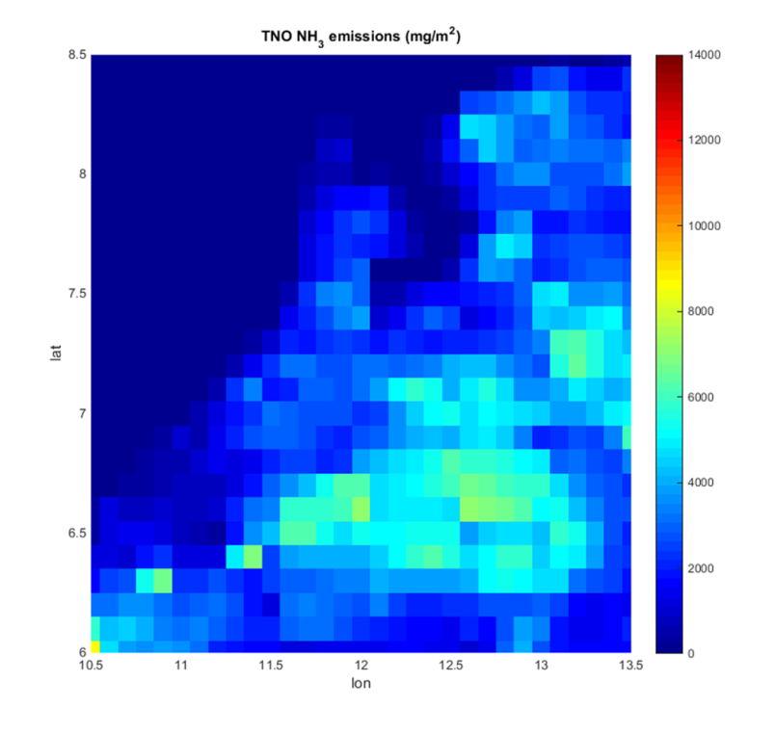
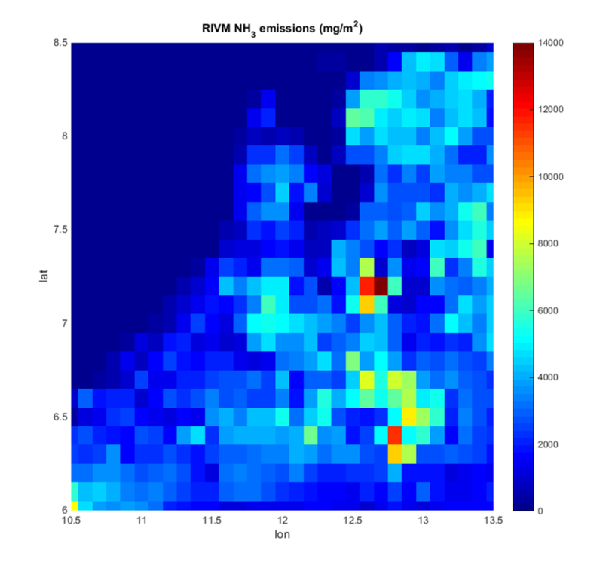
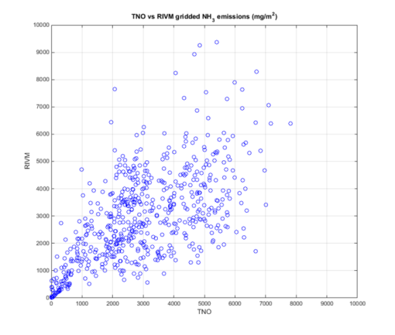
Poorly correlated NH₃ emissions in The Netherlands
Two emissions datasets are available for NH₃ in the Netherlands:
  TNO-MAC3 European emission database (0.1º)
  The original emissions from RIVM (1 km + individual farm buildings)
Spatial correlation between RIVM and TNO-MAC3 emissions is poor (R²=0.38), but the total emissions are the same
When TNO-MACC3 emissions are used in EMEP then uEMEP spatial correlation decreases from R² = 0.67 to R²=0.43
TNO-MAC3 0.1º emissions
RIVM emissions
Scatter RIVM/TNO emissions

Slide 20
A summary of uEMEP
The local source calculation in ls-uEMEP can be used for downscaling but also for source allocation within local regions
ls-uEMEP is part of the latest open source EMEP/MSC-W code (https://github.com/metno/emep-ctm)
The downscaling part of uEMEP (ds-uEMEP) can be applied on annual data (rotationally homogenous Gaussian model) or hourly data (standard Gaussian plume)
Can be applied anywhere in Norway (have complete proxy data for traffic and shipping) for NO₂ and provides similar results to existing local models
In The Netherlands NH₃ downscaling provides similar results to existing local models
Still under development with aim to implement over larger regions but appropriate proxy data on European scale is not directly available

Slide 21
A general summary
From a regional scale perspective sub-grid downscaling of CTM grids is like magic, allowing regional models to produce local scale concentrations
From a local scale perspective it is just simple Gaussian dispersion with a different way of including background concentrations
So what is the advantage of this?
Given appropriate emission/proxy data then large regions can be modelled at high resolution (country, continent)
It makes local scale modelling available for regional modellers allowing ‘scale closure’ for regional models
It clearly reveals discrepancies between regional and local emissions and will help, in the long run, to reduce these inconsistencies
What is an appropriate emission database for this application?
An appropriate emission database is one that can be aggregated or disaggregated consistently, that includes not just emissions but the underlying data used to make the emissions

Slide 22
Thank you

Slide 23
2 day forecast for NO₂ at 25 m for all stations in Norway
Comparison uEMEP and EMEP (2.5 km)

